Slide 1
Methodologic Considerations
Marc F. Swiontkowski MD
University of Minnesota
Department of Orthopaedic Surgery
Editor in Chief JBJS

Slide 2
Disclosure
JBJS Editor
JBJS EST,CC,Reviews,JOPA Editor-In-Chief
NIH/NIAMS funding
Editor Skeletal Trauma
Former CEO TRIA Orthopaedic Center
DSMB Chair METRC Consortium

Slide 3
Introduction
Eng Lee MD, FRCS (C)
Department of Orthopaedic Surgery ,National University of Singapore,
Deputy Editor Journal of Bone & Joint Surgery
Daisuke Togawa MD, PhD
Department of Orthopaedic Surgery, Hamamatsu University School of Medicine
Deputy Editor Journal of Bone & Joint Surgery
Marc Swiontkowski MD, Minneapolis, Minnesota
Professor Department of Orthopaedic Surgery University of Minnesota
Editor In Chief Journal of Bone & Joint Surgery

Slide 4
Symposium Outline
Critical Principles of Medical Writing –
Eng Lee MD,PhD
Preparing a Manuscript for Publication
Dasiuke Togawa MD
Methodologic Considerations
Marc Swiontkowski MD
Why Participate in the Peer Review Process?
Dr.’s Lee, Togawa, Swiontkowski

Slide 5

Critical Principles of
Medical Writing
Eng Hin LEE, MD, FRCS(C)
Deputy Editor, JBJS
Professor of Orthopaedic Surgery
National University of Singapore

Slide 6
Why write?
To remember (permanent record)
To understand better (sharpen thoughts and gain perspective)
To improve critical thinking
To communicate thoughts, ideas and techniques
To stimulate discussion and validation
To advance scientific knowledge and change practice
To protect intellectual property

Slide 7
Why publish?
For academics
“Publish or perish” for P&T and grant applications
Contribute new knowledge and techniques
Increase visibility and reputation
Increase professional contacts and collaborations
Attract graduate students
Invitations to speak
Win awards

Slide 8
Why publish?
For Clinicians
Sharing skills, knowledge and outcomes
Change practice
Increase visibility and reputation
Increase professional contacts
Attract residents and fellows
Increase patient referrals
Invitations to speak
Win awards

Slide 9
Why publish?
Chance to be famous and be remembered
(leave a legacy)

Slide 10
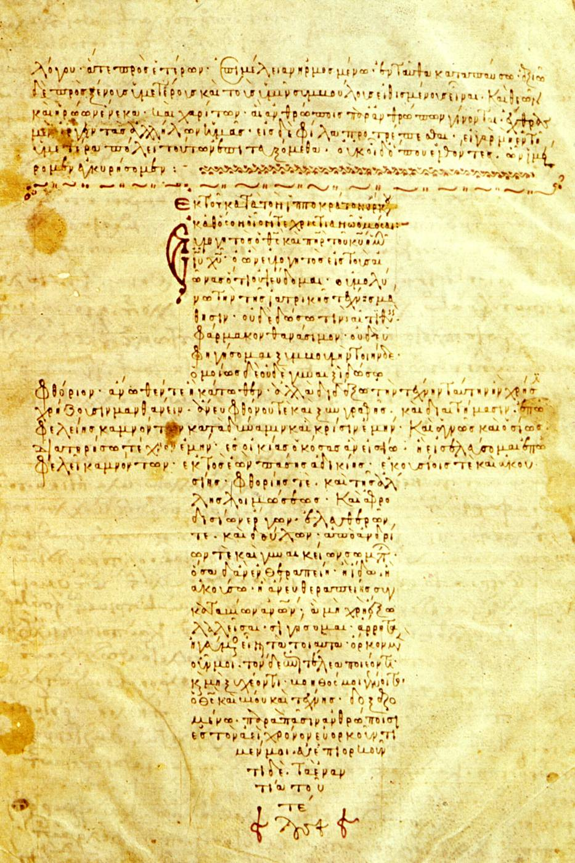
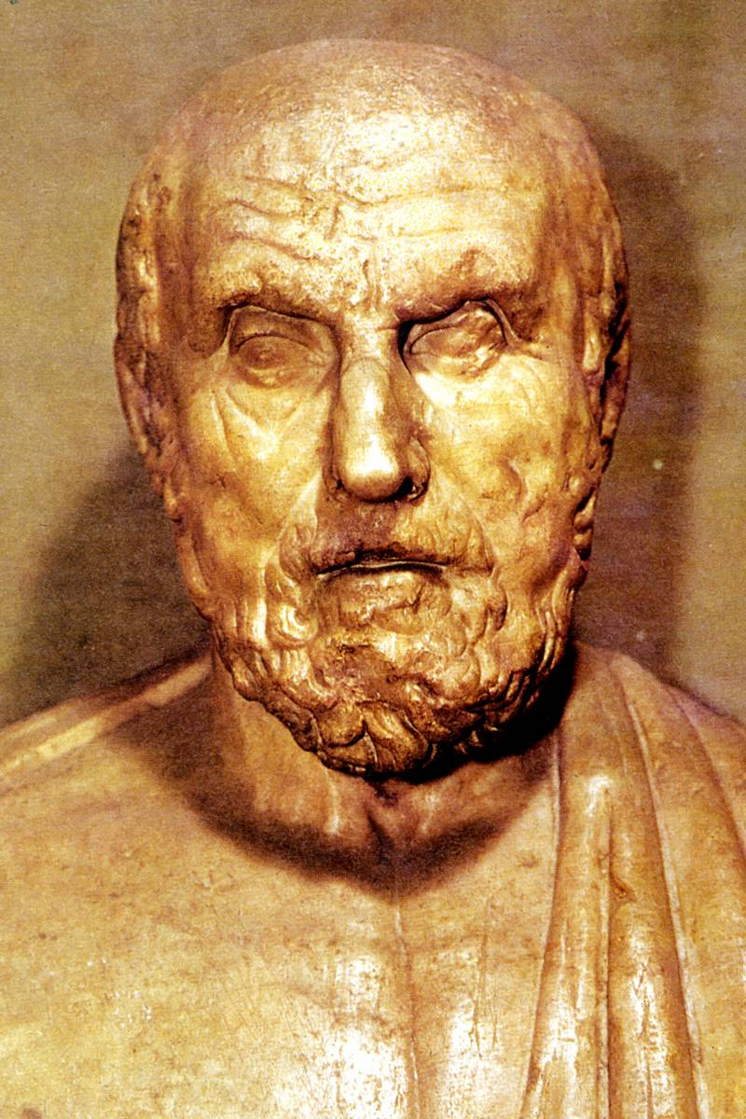
Publishing is not new!
Hippocrates

Slide 11
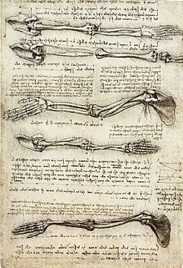
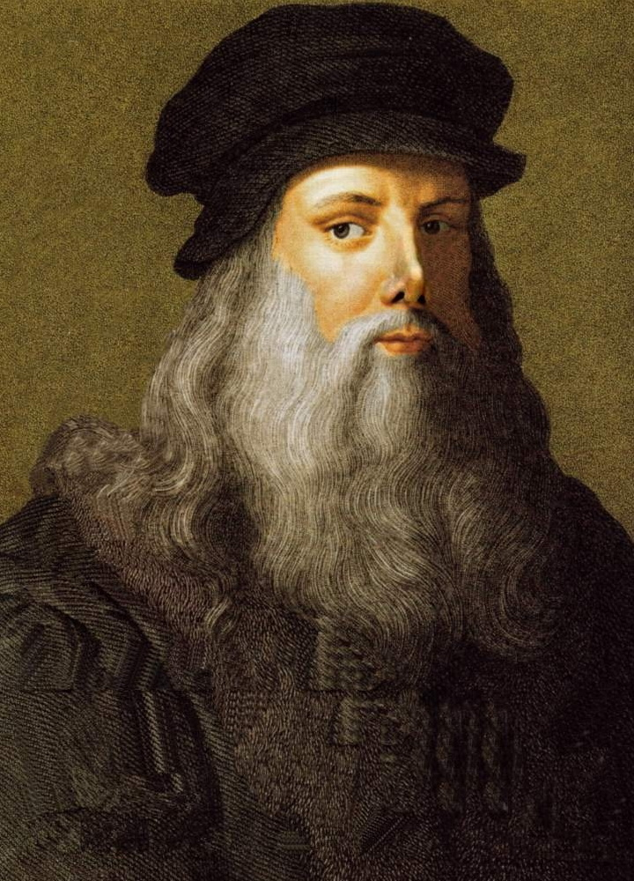
Leonardo da Vinci

Slide 12
Know these names?
Robert Salter
Malcolm Menelaus
Paul Harrington
Joseph Schatzker
Charles Neer II
John Charnley
John Insall
Ramon Gustilo
Why do you
remember them?

Slide 13
How do I start?
Think of a clinical or research question that you want answered
Get a few people with relevant expertise involved
Do a literature search to see what work has been done in the area
Will your research fill a gap in knowledge or is it totally novel?
Decide on the type of study to do
Decide where to publish (who are your readers?)
Write the paper up according to the guidelines of the journal

Slide 14

Before you start……..
Consult a Methods and Statistics expert

Slide 15

What is Medical Writing?
Factual, scientific and technical
Not literary or flowery
Know the subject well
Write for the intended audience
Follow the structure and editorial policies of the journal
Writing should be simple and concise
Use good English with proper syntax, grammar and sentence structure

Slide 16
Important Tips
Establish the full structure of the article in your mind before starting to write
Avoid “salami-slicing” your work to get more publications
A single paper should address one theme
Most important information is at the beginning of each sentence in the paragraph
Keep sentences short and concise (succinct)
Each paragraph contains one idea or concept

Slide 17
Important Tips
Avoid colloquial words and phrases
Use acronyms that are universally accepted
Present data clearly - use tables to condense data
Use appropriate number of illustrations and figures
Label all illustrations, figures and tables accurately
Cite primary source rather than review article
Discussion must be relevant to the study
Supplemental data can be added in online version

Slide 18
Citation and Quotation Errors
      4 orthopaedic peer-reviewed journals:
      200 articles
      Citation errors = 26% (mostly minor)
      Quotation errors = 38%
      Davids et al: JBJS-A, 2010

Slide 19
Important Tips
Show the draft(s) of the manuscript to a colleague for comments and criticisms
Submit final manuscript with a cover letter and ensure all required forms are completed
Unconditional acceptance by a journal is rare
Respond fully to reviewers’ comments if asked to re-submit
Learn from the comments if rejected and send to an appropriate journal

Slide 20
General Guidelines
Top journals usually publish original research studies
More likely to accept level I, II and III studies (includes systematic reviews)
Case reports are only accepted by some journals
Case series without controls (level IV) have poorer chance of getting into top journals (exceptions?)
Prospective studies better than retrospective studies

Slide 21
Research Integrity Issues
Authorships
Plagiarism
Duplicate publications
Fabrication and falsification of data
Ethics board approvals for research on animals and humans
Keep good records and store data in safe place

Slide 22
Research Integrity Issues
Authorships
Plagiarism
Duplicate publications
Fabrication and falsification of data
Ethics board approvals for research on animals and humans
Keep good records and store data in safe place

Slide 23

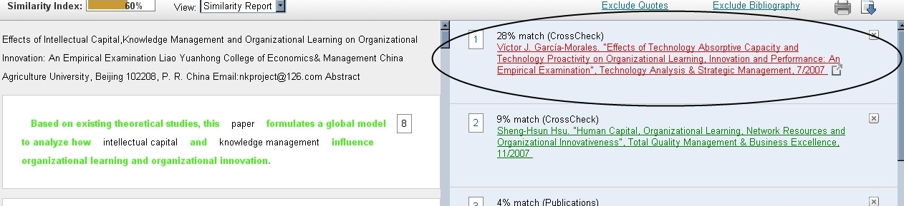


Plagiarism software
  Cross check used by JBJS
  Free plagiarism software

Slide 24
Research Integrity Issues
Authorships
Plagiarism
Duplicate publications
Fabrication and falsification of data
Ethics board approvals for research on animals and humans
Keep good records and store data in safe place

Slide 25
Research Integrity Issues
Authorships
Plagiarism
Duplicate publications
Fabrication and falsification of data
Ethics board approvals for research on animals and humans
Keep good records and store data in safe place

Slide 26
Research Integrity Issues
Authorships
Plagiarism
Duplicate publications
Fabrication and falsification of data
Ethics board approvals for research on animals and humans
Keep good records and store data in safe place

Slide 27
Research Integrity Issues
Authorships
Plagiarism
Duplicate publications
Fabrication and falsification of data
Ethics board approvals for research on animals and humans
Keep good records and store data in safe place

Slide 28
Good work and persistence pays!

Slide 29
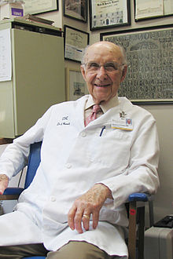
Ignacio Ponseti (1914-2009)
Arrived in Iowa in 1941 after serving in the Spanish Civil War as MO and escaping to France and Mexico
Trained as an orthopaedic surgeon with Steindler
Developed non-surgical approach to management of clubfoot
Faced many challenges for 50 years before method was accepted universally

Slide 30
The happiest outcome is……..
To get a paper accepted “as is” without any revision required!
This will happen if you are meticulous in your preparation and writing and have no mistakes in the text, figures or tables.

Slide 31
“Reading maketh a full man, conference a ready man and writing an exact man”
Francis Bacon

Slide 32
Happy Writing!

Slide 33
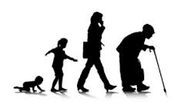

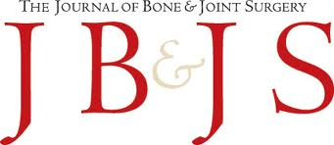
Preparing a Manuscript for Publication
Asian Pacific Orthopaedic Association Meeting 2016, Melbourne, Australia
Daisuke Togawa, MD, PhD
Deputy Editor, The Journal of Bone and Joint Surgery
Associate Professor
Section of Geriatric Musculoskeletal Health
Department of Orthopaedic Surgery
Hamamatsu University School of Medicine
Japan
Notes:
Thank you, Marc. Hello, everyone. My name is Daisuke Togawa, a deputy editor of JBJS. I am from Hamamatsu, Japan. I am going to talk about ‘preparing a manuscript for publication’ .

Slide 34
Preparing a Manuscript for Publication
Daisuke Togawa, MD, PhD
Disclosure
I have a potential conflict with this presentation due to being Deputy Editor of the Journal of Bone and Joint Surgery which is a paid position.
Acknowledgements
Vernon Tolo, MD, former Editor-in-Chief
Charles R. Clark, MD, Deputy Editor
Notes:
This is my disclosure. I would like to acknowledge Dr. Vernon Tolo, formar editor-in-chief, and Dr. Charles Clark, also a deputy editor of JBJS for this talk.

Slide 35
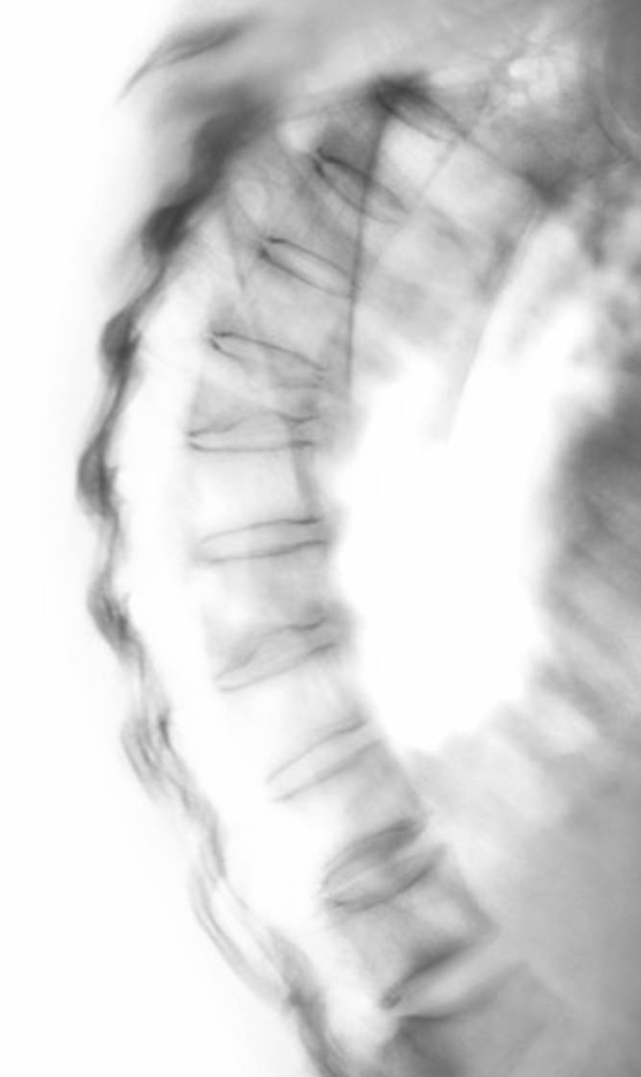
Preparing a Manuscript for Publication
Level of Evidence
Sex & Gender consideration
Manuscript Preparations
Notes:
Today, I am going to talk about the three topics listed in this slide. Level of evidence, sex & gender consideration, and manuscript preparations. Now I will start with the first one, level of evidence.

Slide 36
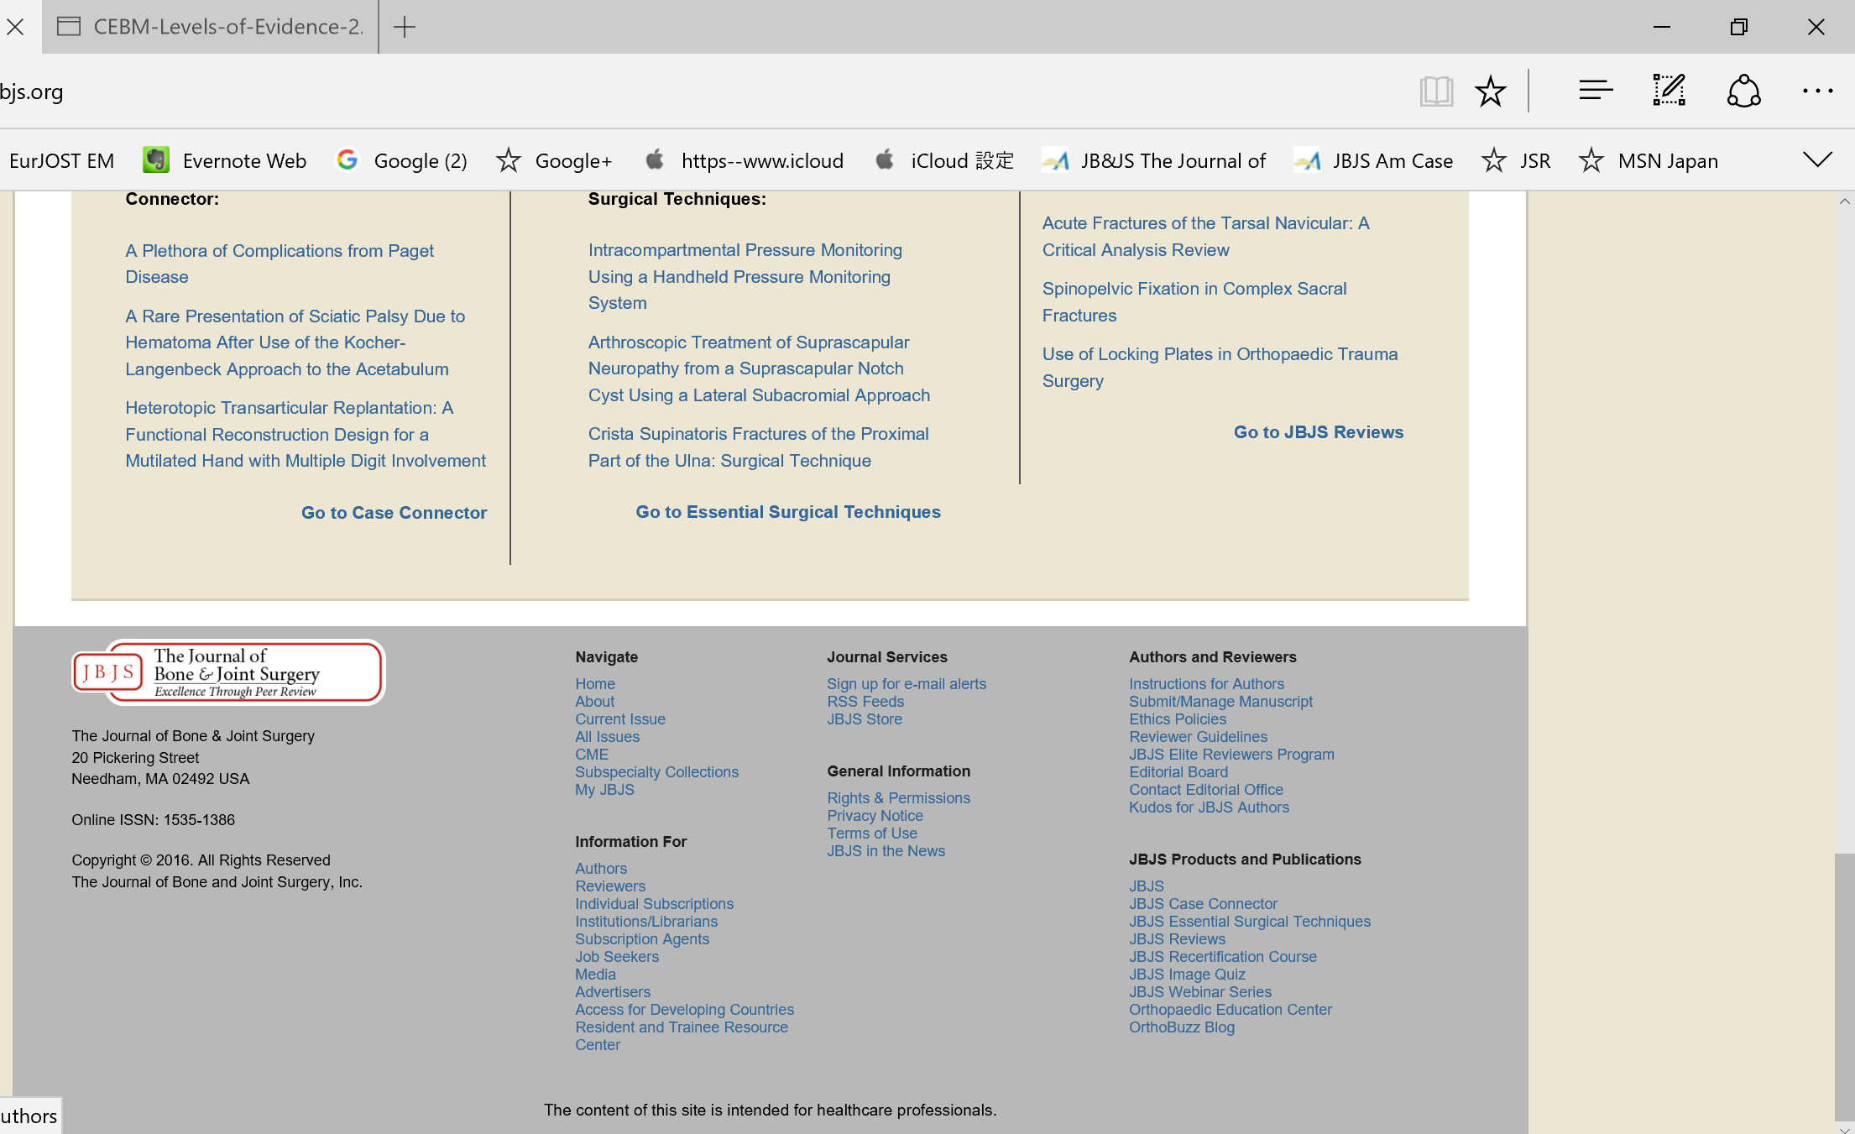
Level of Evidence
http://jbjs.org/level-of-evidence
Notes:
There are a number of literatures in the world. When we research, we need to recognize which one is more important and significant. According to the evidence-based medicine, we can look at the evidence table. It is also available from our JBJS website.

Slide 37
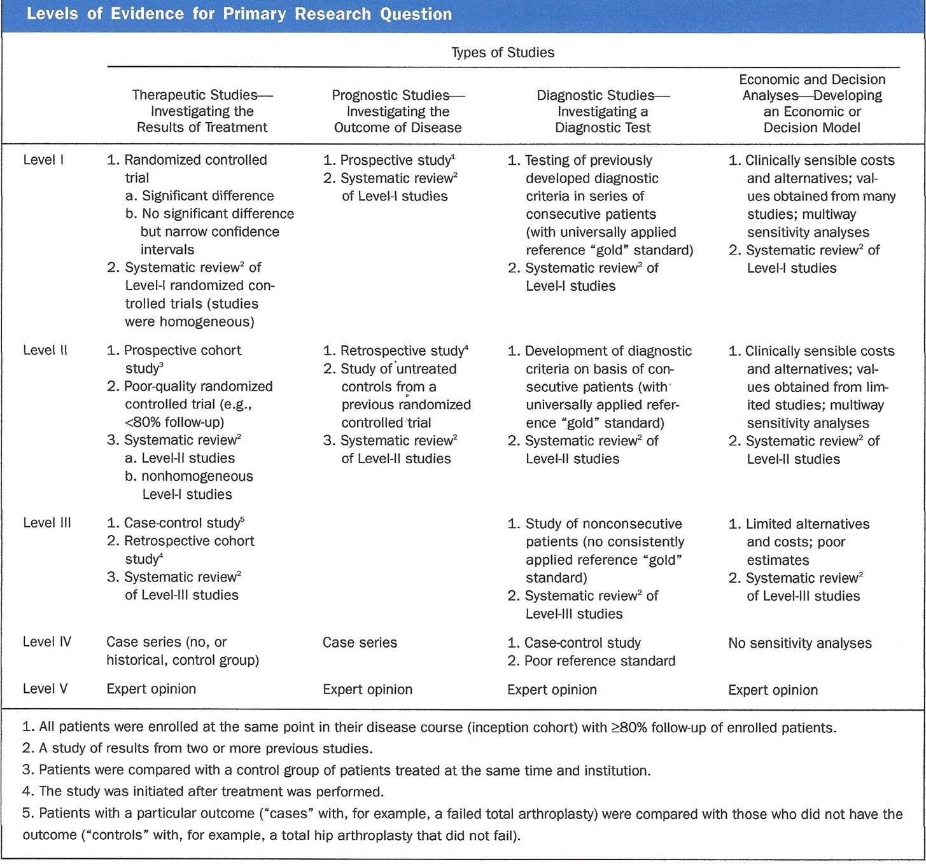
Level of Evidence – Type of Studies
Therapeutic Studies
  Investigation the Results of Treatment
Prognostic Studies
  Investigating the Outcome of Disease
Diagnostic Studies
  Investigating a Diagnostic Test
Economic and Decision Analyses
  Developing an Economic or Decision Model
Notes:
There are 5 levels in this table in each type of studies. Study types are devided into 4 types, therapeutic study, prognostic study, diagnostic study, and economic and decision analysis.

Slide 38
Level of Evidence – Level I
e.g.
Multicenter Randomized Controlled Trials
Systematic Review of Level 1 RCTs
Notes:
This is the level 1 studies in each type. Typically, multicenter randomized controlled trials and systematic review of level 1 RCTs are categorized in this level.

Slide 39
Level of Evidence – Level II
e.g.
Prospective Cohort Studies
Poor-quality RCTs
Systematic Review of Level II studies
Notes:
This is level 2. Typically, prospective cohort studies, RCTs with lower quality, and systematic reviews of Level 2 studies are categorized here.

Slide 40
Level of Evidence – Level III
e.g.
Case-control Studies
Study of non-consecutive patients
Systematic Review of Level III studies
Notes:
Level III, Case-control studies, study of non-consecutive patients, and systematic reviews of Level III studies are called as level III study.

Slide 41
Level of Evidence – Level IV & V
e.g. Level IV
Case Series with no or historical control
Manuscript with higher evidence level has a greater chance of publication…
Notes:
Level IV, case series with no control group are categorized here. Expert opinions are Level V. In general, manuscript with higher evidence level has a greater chance of publication.

Slide 42
Level of Evidence
Notes:
When we submit the manuscript, review and read the papers, we need to know which level the paper should be categorized according to this table.

Slide 43
Preparing a Manuscript for Publication
Level of Evidence
Sex & Gender considerations
Manuscript Preparations
Notes:
Let’s move on to the second topic, sex and gender consideration.

Slide 44
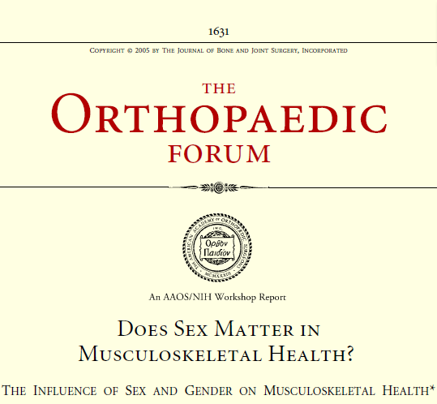
Sex and Gender Considerations
Disease prevalence differs between men and women
Sex: Chromosomes
Gender: a person’s self representation as male or female
Tossi, LL, et al. J Bone Joint Surg Am. 2005 Jul;87(7):1631-47.
Notes:
Recently, reseach

Slide 45
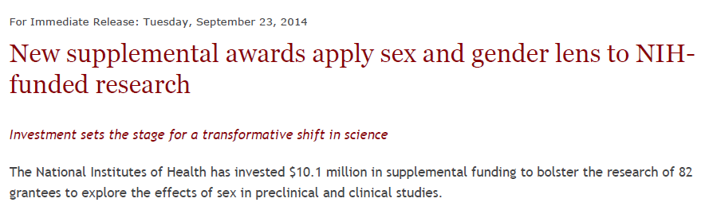
NIH announcement Sep.23, 2014

Slide 46
In the abstract,
Ex.
300 patients (128 males, 172 females, average age 58) were recruited in this study.
Male
<reasons>
???
Female
<reasons>
???
very rare to considerate the mechanisms that causes differences…

Slide 47


Sex and Gender Influences on Health
Biological classification, encoded in our DNA
  Males have XY chromosomes
  Females have XX chromosomes
Sex makes us male or female
Every cell in our bodies has a sex
Making up tissues and organs
Socially constructed roles, behaviors, expressions, and identities
How they act and interact
How individuals and groups understand, experience, and express it
NIH office of Research on Women’s health

Slide 48

Mental Health
Women are twice as likely as men to experience depression, with some women experiencing mood symptoms related to hormone changes during pregnancy and perimenopause
Women are more likely to admit to negative mood states and to seek treatment for mental health issues, in contract to men
NIH office of Research on Women’s health

Slide 49
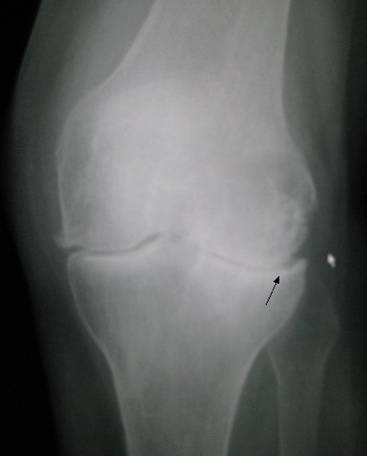
Knee arthritis
Women and girls are more likely to injure their knees when playing sports, in part due to their knee and hip anatomy, imbalanced leg muscle strength, and looser tendons and ligaments.
Walking in high-heeled shoes increases stress on the knee joint, placing women at increased risk of developing osteoarthritis
NIH office of Research on Women’s health

Slide 50
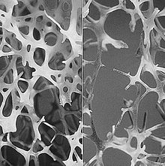
Osteoporosis
Osteoporosis is more common in women because they have less bone tissue than man and experience a rapid phase of bone loss due to hormonal changes at menopause
Osteoporosis in men older than 50 can go undetected and is often undertreated because patients and providers think of osteoporosis as a “woman’s disease’
NIH office of Research on Women’s health

Slide 51
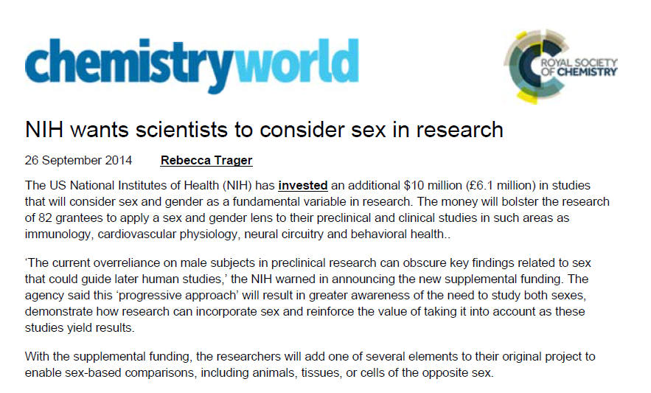
Sex and Gender issues are important !

Slide 52
Preparing a Manuscript for Publication
Level of Evidence
Sex & Gender considerations
Manuscript Preparations

Slide 53

Prior to Writing
Prepare an outline: essential
Read/follow “instructions to authors”
Become familiar with particular style requirements
Re-review the relevant literature
Determine authorship

Slide 54

Manuscript Preparation
- Introduction -
Focus: Why?
Concise statement of the problem
Brief reference to pertinent literature
More detailed literature citation: Discussion
Conclude with a statement of purpose/hypothesis

Slide 55
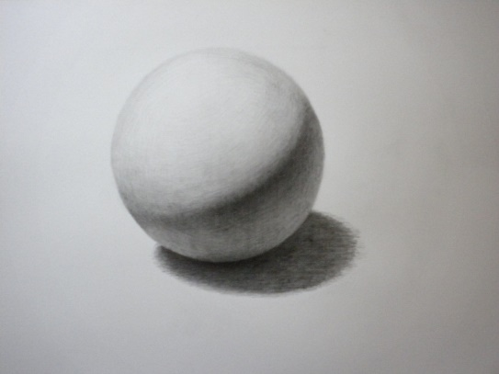
Manuscript Preparation
- Materials and Methods -
Focus: How? on Whom?
Population (demographic data)
Period of study
Location of study
Patient selection: inclusion/exclusion criteria

Slide 56

Manuscript Preparation
- Materials and Methods -
Focus: How? on Whom?
Statement of patient protection: informed consent, IRB approval, study registration
Description of patient treatment: technique, indications, contraindications
Statistical technique
Source of funding

Slide 57
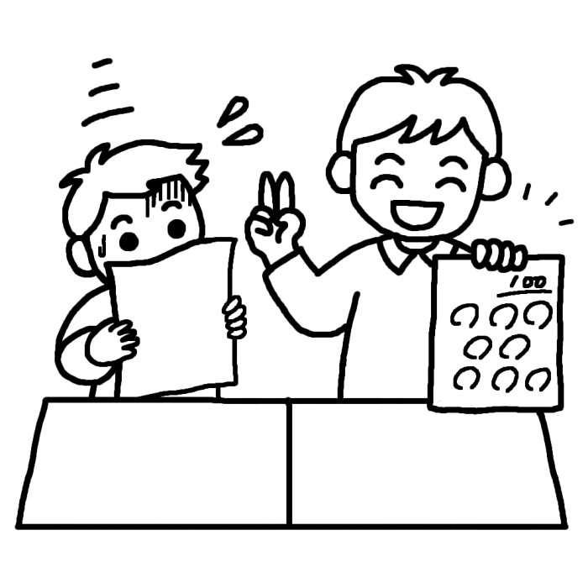
Manuscript Preparation
- Results-
Focus: What?
Detailed data report (tables helpful)
Consistency
Bilateral confusion (# patients, # procedures)
Per cent (decimal places, N<20, #s and %s)
Accuracy counts
Problem words (jargon, cases, incidence/prevalence, significant, sacrifice)

Slide 58
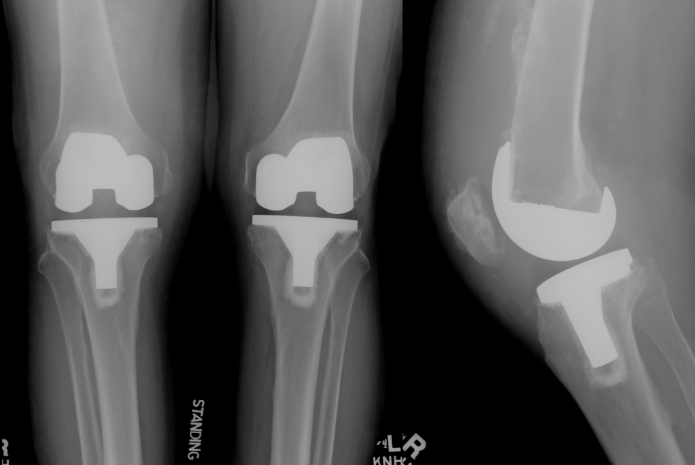
TKA - Bilateral Procedures
e.g. 78 total knee arthroplasties were performed in 50 patients and 47 were successful.
47 patients?
47 knees?

Slide 59

Percent vs. Numbers
Overly accurate
- 93 patients, 79.612%
N < 20
- misleading
- 1 of 2 versus 50%
Corresponding numbers

Slide 60

Manuscript Preparation
- Discussion-
Focus: Why important? Who cares?
Briefly re-state purpose
Briefly describe important findings: purpose achieved or not
most relevant literature
Strengths/weaknesses/limitations
Don’t overstate conclusions: base on findings

Slide 61

Manuscript Preparation
- Figures-
Focus: illustrate your results
Not a photo album
Exclude normal side
Plan as part of text
Illustrate important points
Color helpful

Slide 62
Manuscript Preparation
- Tables-
Focus: summarize your results
Briefly summarize information in text
Not a PowerPoint slide from a presentation
Take up space
Should add information
Consider appendix for supplementary tables
Werner et al. JBJS Am 2013

Slide 63

Manuscript Preparation
- Appendix-
Focus: to emphasize your study…
Surgical technique
Raw data
Technical information
Publish electronically?

Slide 64

Manuscript Preparation
- References-
Focus: to lead your study on the road…
Search for references
Read them (not just Abstract)
Understand them
Use correctly
Cite correctly

Slide 65
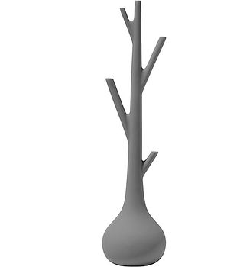
Manuscript Preparation
- Abstract -
Focus: Be Concise
write after the manuscript is completed
Background: state the problem
Methods: what was done
Results: report results
Conclusions
Clinical Relevance (basic science)
Exclude interesting but non essential information

Slide 66
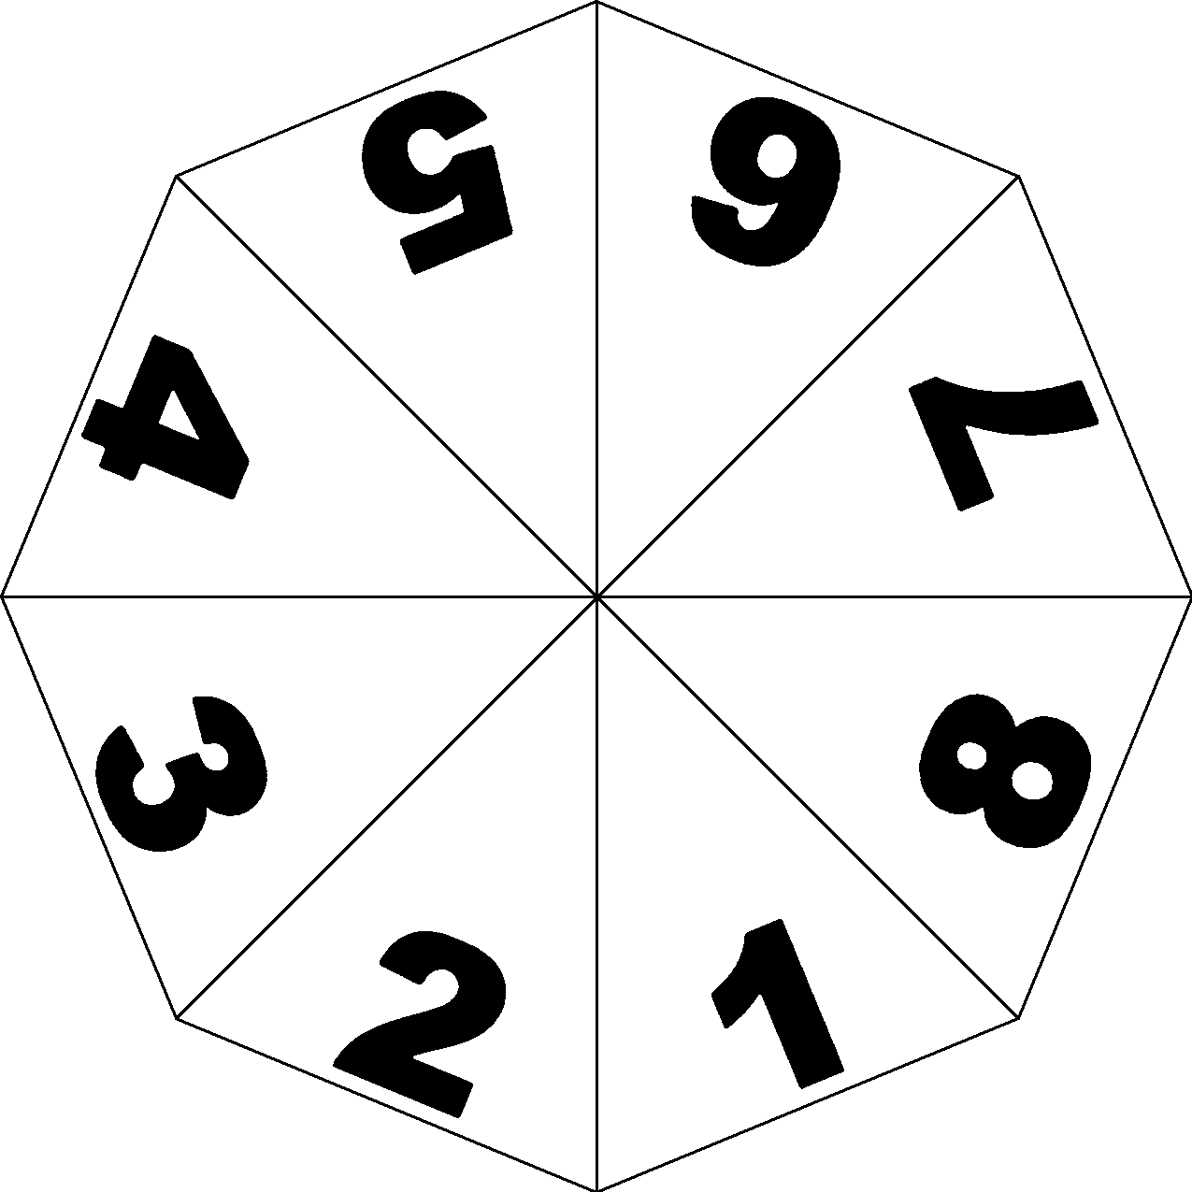
Manuscript Preparation
- Authorship -
Focus: Discuss and Appreciate
Order: reflects preference of authors
Criteria: each author must have contributed significantly to, and be willing to take public responsibility for, one or more aspects of the study:
  study design
  data acquisition
  data analysis
  data interpretation

Slide 67

Manuscript Preparation
- Authorship -
Focus: Discuss and Appreciate
Duties:
  active involvement in drafting manuscript
  provide final approval
Acknowledgement:
  individuals who have contributed to only one aspect of the study or contributed only cases

Slide 68

Manuscript Preparation
- Length of Manuscript -
Focus: Set up
Varies with journal: Instructions to Authors
Manuscript: typical 3000 - 4000 words max
Structured Abstract: 300 - 325 max
No detailed review of the literature
Typical manuscript:
  1 page: Abstract and Introduction
  3 pages each: Methods, Results and Discussion

Slide 69

Manuscript Preparation
- Manuscript Processing -
Submission
  in house evaluation/processing
Editor assigned to manuscript
  2 reviews typical
  conflict of interest issues
Decision options
  Accept (typically with revision[s] required)
  Reject - Additional review
Conflicting reviews
  Most journals: adjudication process
Methods/statistics review
Editing/copy editing
Publication

Slide 70

Manuscript Preparation
- Publication Ethics -
Focus: Double Check
Committee on Publication Ethics (COPE)
Self-plagiarism: Test Recycling
Duplication of data: always serious
Common Methods: always cite
Significant concerns – duplicate:
- hypothesis
- discussion
- conclusions
Journal editor actions: correction or retraction of article

Slide 71
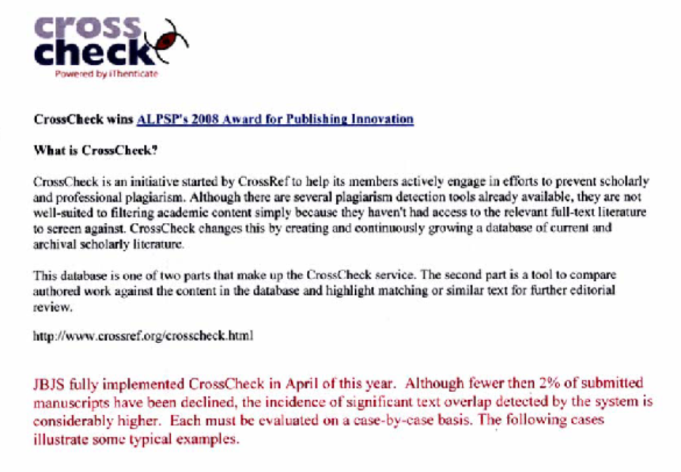
To avoid the Plagiarism…
- Pub Med search for related articles
- Cross Check for plagiarism
Manuscript Preparation
- Publication Ethics -

Slide 72

Preparing a Manuscript for Publication
In Summary
Planning: essential
Prepare an outline first!
Read full references
Understand the purpose and content of the parts of a manuscript
Be concise and avoid redundancy
Don’t overstate conclusions

Slide 73
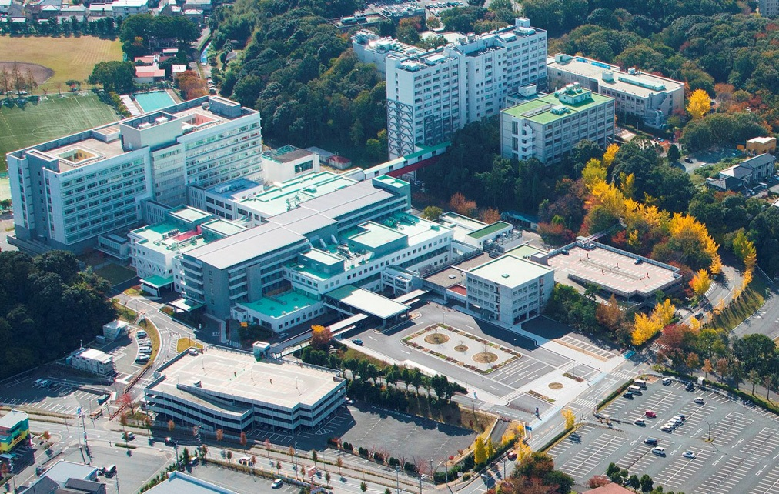
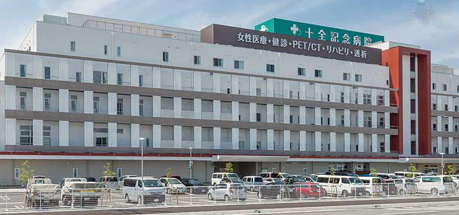


Thank you
Meitoku Medical Institution
Jyuzen Memorial Hospital

Slide 74
Outline-Methodologic Considerations
Limitations of research methods
What is an adequately powered sample?
What are the sources of bias and how can they be addressed?
Use the appropriate statistical test
Reference tool for RCT
Reference tool for observational studies

Slide 75
Limitations of Research Methods
Case reports, cohort studies, cross-sectional studies- biased samples
Case Control studies- biased control groups
RCT’s- generalizability of results
  Effectiveness trials vs Efficacy trials

Slide 76
Most Research designs only demonstrate associations
Cause and effect can only be inferred
Biologic plausibility, dose effect phenomena, temporal relationships
Cause and effect can generally only be claimed in prospective randomized trials
Authors must know the limitations of their study design

Slide 77
What does it mean to have an adequately powered sample?
Type I error- The probability that an observed difference has occurred by chance is 5% or less- p<0.05
Type II error- The probability that an observed difference is not statistically significant has occurred because of inadequate or biased sampling- 20% risk is the threshold- the absence of a difference does not mean that the groups are equivalent!

Slide 78
What are the potential sources of bias and how are they to be addressed?
Case series, Cohort studies
  “Consecutive” does not limit potential
  Referral bias
  Selection bias
  Spectrum bias
Case Controls
  Both subjects and controls as above
  Selection of controls is critical
  At least 2 per case, random selection

Slide 79
Potential Sources of Bias, cont’d
RCT
  Randomization distributes confounders evenly
  Small trials at risk for maldistribution
  Sample size estimate only addresses number needed to achieve result- doesn’t protect against faulty randomization
  Authors are obligated to consider all potential sources and evaluate the impact on observations

Slide 80
Use the appropriate statistical test
Input from a statistician in planning
Understand assumptions in choosing the test
  T-test only where variable is continuous and normally distributed
Use conservative non-parametric test if the distribution of the continuous variable is unknown
If multiple pairwise comparisons, lower threshold of P is required

Slide 81
Reference Tool for RCT’s
CONSORT statement should be referenced
CONSORT flow diagram is required by many Journals
Blinded outcome assessment is a straightforward step often neglected in Orthopaedic trials (of all designs)

Slide 82
Reference tool for Observational Studies
STROBE statement is underutilized
Checklist of 22 items
Relevant for Cohort studies, Case Control studies, Cross Sectional studies
Ideally completed in advance of the initiation of data collection
JBJS Forum 95(3) 2/6/13 Sheffler et al

Slide 83
Participants #13
Report numbers of individuals at each stage of the study-#eligible, #examined for eligibility, confirmed eligible, # included, # completed follow up and analyzed
Reasons for non-participation at each stage
Consider the use of a flow diagram

Slide 84
Outcome Data #15
Cohort study-report numbers of outcome events or summary measures over time
Cohort-Controlled study- report numbers in each exposure category or summary measures of outcome
Cross-Sectional study-report numbers of outcome events or summary measures

Slide 85
Why Participate in the
Peer Review Process?
What are the opportunities?
  Scientific Review
  Associate Editor
  Deputy Editor
What are the benefits to the individual?
  Share your expertise
  Participate in decision making for the field
  Increase your knowledge
  Awareness of the “cutting edge”

Slide 86
What are the Responsibilities?
Maintain confidentiality
Declare conflict of Interest issues to the editor
Get help from a colleague if you need support
Don’t spend extra effort to identify authors
Provide timely review

Slide 87
How Do I Get Started?
Be sure you have adequate research/clinical experience
Ask a colleague to share their review processes with you
Approach a Deputy Editor to ask if you would qualify
Never say No and produce quality reviews ahead of the deadline
Use Journal Resources

Slide 88
JBJS Update
JBJS
JBJS Reviews
Essential Surgical Techniques
Case Connector
JOPA
JBJS Open Access

Slide 89
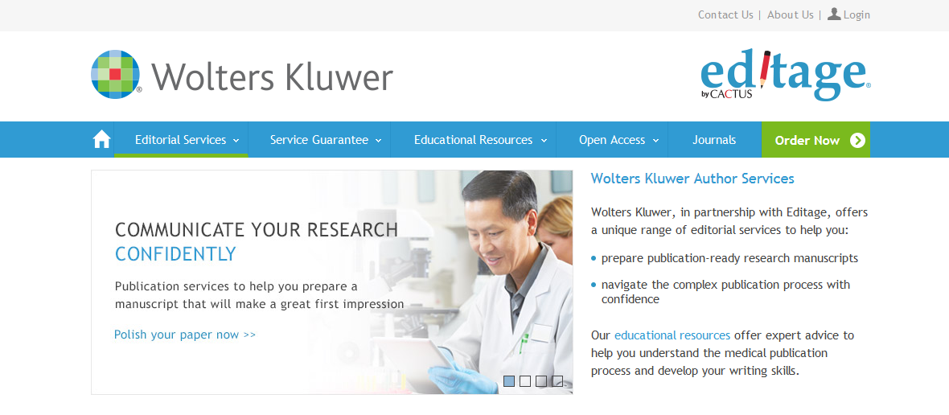
Author Resource Services via WK-Editage Partnership
Manuscript Development
Manuscript editing
Reporting Solid Research
Rapid technical review
Journal Selection/Submission
Resubmission/Revisions
Author Education
Journal formatting
Artwork, graphs, tables
Plagiarism check
Journal recommendation tools and services
Manuscript re-editing
Localized content
Manuscript submission support services
Peer review response check
Re-submission
Workshops
Webinars
89

Slide 90
Author Services at a Nominal Cost Pre-submission
or During Review
Visit Editage to learn more:
http://wkauthorservices.editage.com/
Manuscript Editing Service
Manuscript editing prices vary depending on:
Word count of article
Service option chosen (Advanced, Premium, or PLUS)
Turn around time requested (2-day, 5-day, or 7-day)
Prices (March 2016) | Advanced | Premium | Premium PLUS
1000-2000 words (7-day turnaround) | $214 USD | $357 USD | $411 USD
3000 – 6000 words (7-day turnaround) | $255 USD | $406 USD | $467 USD

Slide 91
Additional Information Sources
JBJS.org
Marc.Swiontkowski@jbjs.org

Slide 92
Editing Examples

Slide 93
There is an increasing awareness of the importance of socioeconomic status in health. Social deprivation has been associated with many diseases such as myocardial infarction, colorectal cancer, diabetes and head trauma and there is evidence that the most deprived spend a greater proportion of their lives with a limiting illness or disability.
In orthopaedic surgery social deprivation has been shown to correlate with musculoskeletal pain, high energy lower limb trauma, Perthes disease and outcome after hip arthroplasty. However, there is little information available about the effect of socioeconomic status on the incidence of fractures. There is some evidence that social deprivation is associated with fractures in children, adolescents and young adult males but the relationship between deprivation and adult fractures has received little attention. Those studies that have been undertaken have been mainly concerned with proximal femoral fractures but the results have been mixed with some studies suggesting a relationship between social deprivation and proximal femoral fractures while others did not.

Slide 94
"Social deprivation has been associated with increasing risk of disease and injury in children and adults. The relationship between risk of fracture in adults and social deprivation has not been investigated."

Slide 95
The Intertan nail was recently launched, and according to the manufacturer the shape of the nail should enhance stability and offer a greater resistance to cutout, (Rucker et al.), presented good clinical results in a study on their first 100 patients operated with Intertan nails. However, no study comparing the Intertan nail with SHS has to date been published. The aim of the present randomized controlled trial (RCT) was to assess whether the Intertan nail, compared to the SHS, with or without a trochanteric stabilizing plate (TSP), would decrease the postoperative pain, improve function, and lower the surgical complication rate in elderly patients with trochanteric and subtrochanteric fractures.

Slide 96
"The Intertan nail was designed to improve proximal fragment fixation in proximal femoral fractures. There have been no controlled trials published examining the clinical and functional outcomes of this implant when used for these fractures as compared to a sliding hip screw".

