Slide 1
PUBLISHING IN JBJS
VERNON T. TOLO, MD
JOHN C. WILSON, JR., PROFESSOR OF ORTHOPAEDICS
KECK SCHOOL OF MEDICINE AT UNIV. OF SOUTHERN CALIFORNIA
EMERITUS CHIEF, CHILDREN’S ORTHOPAEDIC CENTER
CHILDREN’S HOSPITAL LOS ANGELES
CHIEF FOR 22 YEARS
DEPUTY EDITOR FOR PEDIATRIC MANUSCRIPTS, JBJS
FOR 6 YEARS
EDITOR-IN-CHIEF, JBJS FOR 4+ YEARS

Slide 2
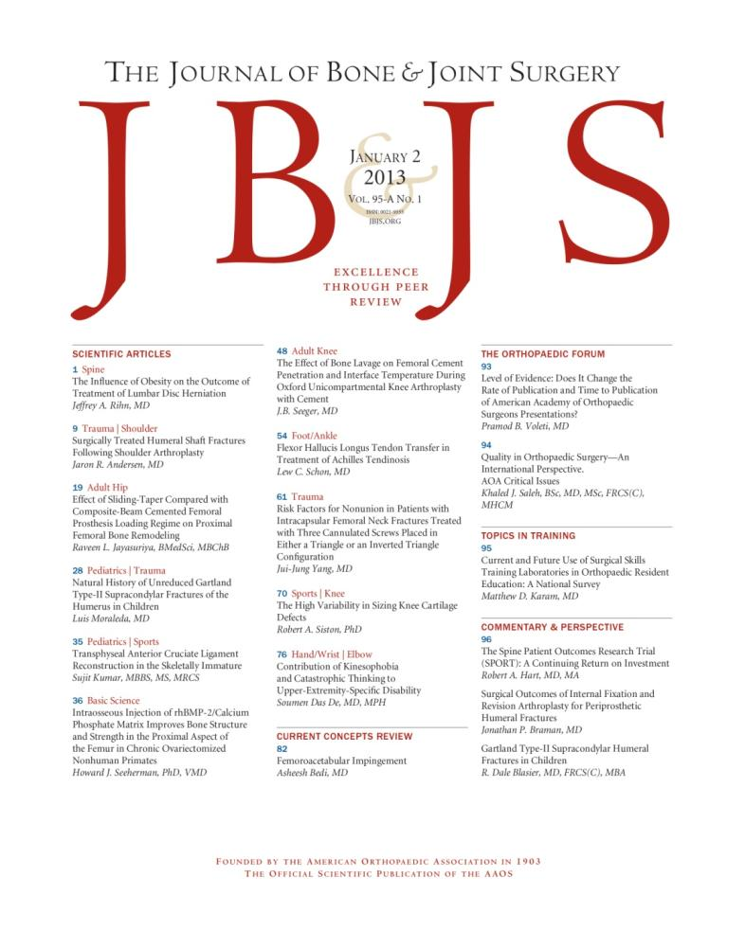
The Journal of Bone & Joint Surgery
125 years of…
www.jbjs.org
The Journal of Bone & Joint Surgery has been the most valued source of information
for orthopaedic surgeons and researchers for 125 years and is the gold standard
in peer-reviewed scientific information in the field. A core journal, which is essential
reading for orthopaedic surgeons worldwide.

Slide 3
PUBLISHING IN JBJS
CHOOSING A TOPIC TO RESEARCH
FOCUS IS ON CLINICAL RESEARCH IN ORTHOPAEDICS
QUESTIONS THAT ARISE IN CONFERENCE DISCUSSIONS
OPEN DISCUSSIONS AT CASE PRESENTATIONS IMPORTANT
ATTENDEES AT ALL LEVELS OF TRAINING ENCOURAGED TO COMMENT
QUESTIONS ABOUT TREATMENT OF INDIVIDUAL PATIENT
DOES THIS ACCEPTED TREATMENT REALLY MAKE SENSE?
DOES THIS NEW DRUG CHANGE BLOOD LOSS AT SURGERY?
DO I REALLY NEED TO IMMOBILIZE PATIENT AS RECOMMENDED?
CRITICAL READING OF JOURNAL ARTICLES
DOES AUTHOR HAVE EVIDENCE TO MAKE STATEMENTS?
IS THERE STILL A QUESTION THAT HAS NOT BEEN ANSWERED?
SKEPTICISM IN STATEMENTS FROM PODIUM PRESENTATIONS
CAREFUL LISTENING OFTEN LEADS TO NEW QUESTIONS ON TOPIC

Slide 4
PUBLISHING IN JBJS
KEY TO SELECT JOURNAL IN WHICH TO PUBLISH
JOURNAL OF BONE AND JOINT SURGERY (JBJS)
WE CONSIDER JBJS A GENERAL ORTHOPAEDIC JOURNAL
PUBLISH SUBSPECIALTY ARTICLES OF BROADER INTEREST
PUBLISH LIMITED BASIC SCIENCE ARTICLES
CLINICAL SUBSPECIALTY JOURNAL
ARTICLES OF MORE NARROW INTEREST
REVIEWER AND EDITOR MAY THINK BETTER IN THIS TYPE JOURNAL
ONE OF THE REASONS FOR REJECTION FROM JBJS
BASIC SCIENCE JOURNAL
RARE TO PUBLISH IN VITRO MANUSCRIPTS IN JBJS
MUST HAVE CLINICAL RELAVANCE FOR MUSCULOSKELETAL ISSUE

Slide 5
PUBLISHING IN JBJS
VARIETY OF ARTICLE TYPES IN JBJS
CLINICAL RESEARCH
PRIMARY ARTICLE TYPE
BASIC SCIENCE RESEARCH
IN VIVO OR BIOMECHANICS
META-ANALYSIS AND SYSTEMATIC LITERATURE REVIEW
ORTHOPAEDIC FORUM
TOPICS IN TRAINING
ETHICS IN PRACTICE
CURRENT CONCEPTS REVIEW
REVIEW ARTICLES OF CLINICAL PROBLEM MUST BE INVITED

Slide 6
PUBLISHING IN JBJS
CLINICAL RESEARCH ARTICLES IN JBJS
TYPES OF CLINICAL STUDIES
CASE CONTROL IS OBSERVATIONAL STUDY WITH CONTROL GROUP
CROSS-SECTIONAL STUDY COLLECTS DATA AT ONE TIME POINT
DETERMINES PREVALENCE
COHORT STUDY IS PROSPECTIVE, LONGITUDINAL
TESTS A HYPOTHESIS OF CLINICAL IMPORTANCE
MOST COMMON TYPE OF MANUSCRIPT SUBMITTED
RANGES FROM RANDOMIZED TRIALS TO CASE SERIES
PREFERENCE FOR STROBE AND CONSORT GUIDELINES
FOLLOW-UP FOR RECONSTRUCTIVE PROCEDURES > 2 YEARS
LEVEL OF EVIDENCE OF STUDY IS IMPORTANT

Slide 7
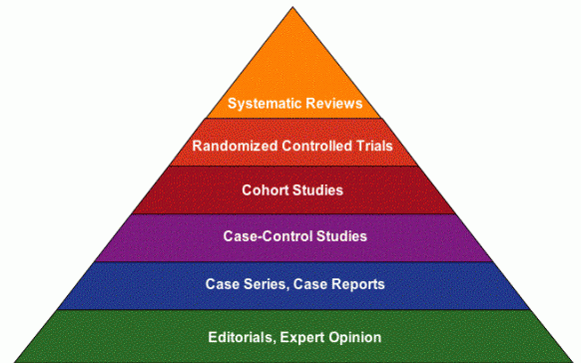
PUBLISHING IN JBJS
CLINICAL RESEARCH ARTICLES IN JBJS
LEVELS OF EVIDENCE
FOLLOWED SINCE 2004 BY JBJS
CASE SERIES REPORT IS LEVEL 4
IF A CONTROL GROUP IS ADDED TO CASE SERIES → LEVEL 3
RANDOMIZED CLINICAL TRIAL IS LEVEL 1
OVER PAST YEAR, 50% DECREASE IN LEVEL 4 SUBMISSIONS WITH INCREASE IN LEVELS 1, 2, AND 3
IN GENERAL, HIGHER LEVELS OF EVIDENCE ARE CITED MORE

Slide 8
PUBLISHING IN JBJS
CLINICAL RESEARCH ARTICLES
RANDOMIZED CONTROLLED TRIALS (RCTs)
USE CONSORT CHECKLIST
25 ITEMS TO INCLUDE IN REPORT
www.consort-statement.org
COHORT, CASE CONTROL, CROSS-SECTIONAL STUDIES
USE STROBE FORMAT
STrengthening the Reporting of OBservational studies in Epidemiology
22 ITEM CHECKLIST
WWW.STROBE-STATEMENT.ORG

Slide 10
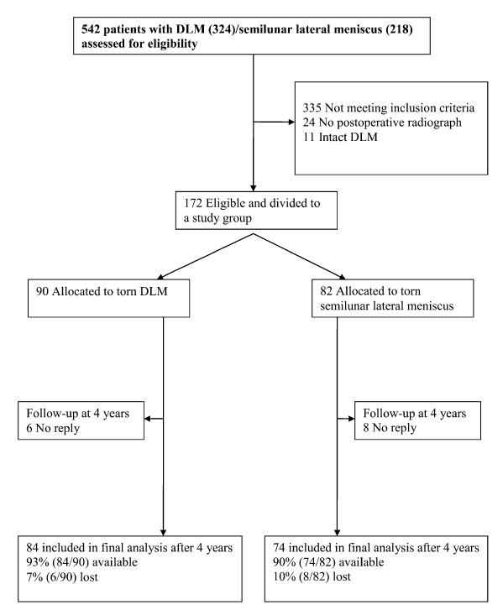
JBJS 2013;95:2008-2014
Example of a CONSORT diagram in a retrospective, case-control study

Slide 11
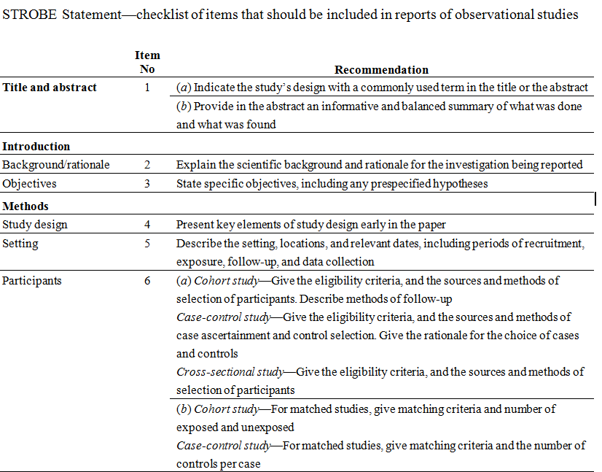

Slide 12
PUBLISHING IN JBJS
BASIC SCIENCE ARTICLES
MAINLY BIOMECHANICS AND ANIMAL STUDIES
IN VIVO STUDIES PREFERRED TO IN VITRO STUDIES
META-ANALYSIS/SYSTEMATIC LIT REVIEW
POPULAR ARTICLE TYPE OVER PAST FEW YEARS
CONFIRM TO PRISMA STATEMENT CRITERIA
IN JBJS, META-ANALYSIS REQUIRES ALL LEVEL 1 AND 2 STUDIES
SYSTEMATIC LITERATURE REVIEW IF LEVEL 3 OR 4 STUDIES TOO
VALUE OF REVIEW = STUDY LEVEL OF EVIDENCE REVIEWED
IN ORTHOPAEDICS, MOST PUBLISHED STUDIES WITH LOW EVIDENCE

Slide 13
PUBLISHING IN JBJS
TOPICS IN TRAINING
REPORTS EFFECTIVE NEW METHODS OF TEACHING/TRAINING
QUESTIONAIRE STUDIES USUALLY NEED >40% RESPONSE RATE
ORTHOPAEDIC FORUM
WIDE VARIETY OF TOPICS
LESS SCIENTIFIC STUDY BUT REQUIRES GOOD STUDY DESIGN
CURRENT CONCEPTS REVIEW
REVIEW ARTICLE
AUTHORS SUBMIT A TOPIC IDEA TO DEPUTY EDITOR
REVIEW ARTICLES NOT FOLLOWING THIS PROCESS NOT ACCEPTED
IF TOPIC IS ACCEPTED, MANUSCRIPT WILL BE PUBLISHED

Slide 14
PUBLISHING IN JBJS
NEEDED BEFORE YOU START YOUR RESEARCH
SELECT APPROPRIATE RESEARCH TOPIC
RESULTS NEED TO BE OF INTEREST TO OTHERS
STATE HYPOTHESIS
BEST IF ONE HYPOTHESIS IS TESTED, NOT MULTIPLE HYPOTHESES
HAVE STUDY DESIGN ESTABLISHED
SOLICIT ADVICE FROM METHODS/STATISTICS EXPERT PRE-STUDY
CONSULT STATISTICIAN TO KNOW PATIENT NUMBERS NEEDED
LACK OF STATISTICAL POWER COMMON IN ORTHO STUDIES
CHANCE OF ERRONEOUS CONCLUSION HIGHER WITH LOW POWER

Slide 15
PUBLISHING IN JBJS
NEEDED BEFORE YOU START YOUR RESEARCH
OBTAIN APPROVAL FOR STUDY
INSTITUTIONAL REVIEW BOARD OR HOSPITAL ETHICS COMMITTEE
REQUIRED FOR ALL JBJS ARTICLES
REGISTER IF RANDOMIZED CLINICAL TRIAL
ESTABLISH PROTOCOL AND PRIMARY/SECONDARY OUTCOMES
REQUIRED BY JBJS BEFORE PUBLICATION
REGISTRATION IMPORTANT BEFORE STARTING RESEARCH

Slide 16
PUBLISHING IN JBJS
ClinicalTrials.org is most common site in USA but global
Registration of clinical trials
To assure that all patients entered in trial with same protocol
Can change entry criteria and variables mid-study if not registered at start
Change may occur after initial results seen to better prove hypothesis
Many journals require RCTs be registered to be published
Problem with large % not registering before the study begins
From 2007-2010, 48% of eligible trials registered at start
96% less than 1000 patients, 62% less than 100 patients (low power)
Use of DMCs (data monitoring committees) less in industry-sponsored than NIH studies (odds ratio 0.11)
Califf et al., JAMA, 2012

Slide 17
PUBLISHING IN JBJS
MANUSCRIPT PREPARATION
CAREFULLY READ INSTRUCTIONS FOR AUTHORS
DIFFERS FROM ONE JOURNAL TO ANOTHER
SELECT WHICH JOURNAL YOU WILL SUBMIT MANUSCRIPT TO EARLY
KNOW INSTRUCTIONS FOR MANUSCRIPT WHEN STARTING RESEARCH
OUTLINE FULL STRUCTURE OF ARTICLE BEFORE START
SINGLE PARAGRAPH FOR SINGLE SUBJECT
SIMPLE AND CONCISE LANGUAGE
JBJS WITH 3500 WORD LIMIT, WILL DROP TO 3200 THIS YEAR
WORD COUNT DOES NOT INCLUDE REFERENCES AND FIG. LEGENDS
READ AND CITE PRIMARY SOURCE
DO NOT RELY ON REVIEW ARTICLE AS SOURCE

Slide 18
PUBLISHING IN JBJS
REFERENCE ACCURACY IMPORTANT
CITATION OR QUOTATION ERRORS
200 REFERENCES IN 20 ARTICLES IN 4 JOURNALS EVALUATED
CITATION ERROR = 26%
ONLY 4 NOT RETRIEVED FROM PUBMED, USUALLY MINOR
IMPACT FACTOR AND ERROR RATE INVERSELY RELATED
QUOTATION ERROR RATE = 38%
SIMILAR TO OTHER MED JOURNALS
Davids, et al., JBJS 2010
REFERENCE ACCURACY RESPONSIBILITY OF AUTHOR
USE ONLY REFERENCES FROM PRIMARY SOURCE

Slide 19
PUBLISHING IN JBJS
MANUSCRIPT PREPARATION
ABSTRACT MOST COMMONLY READ PART OF ARTICLE
NO MORE THAN 325 WORDS FOR JBJS
SHORT SENTENCE OF BACKGROUND AND HYPOTHESIS
STUDY DESIGN, PATIENT NUMBERS, HOW DATA COLLECTED
RESULTS WITH STATISTICS
CONCLUDE WITH BRIEF SENTENCE OF MAJOR FINDINGS
DO NOT OVER-INTERPRET RESULTS (COMMON)
INCLUDE LEVEL OF EVIDENCE FOR CLINICAL PAPERS
INCLUDE CLINICAL RELAVANCE FOR BASIC SCIENCE PAPERS

Slide 20
JBJS 2013;95:2008-2014

Slide 21
PUBLISHING IN JBJS
MANUSCRIPT PREPARATION
INTRODUCTION
REVIEW OF PRIOR KNOWLEDGE ON SUBJECT
KEEP IT SHORT…..MOST TOO LONG
END WITH HYPOTHESIS TO BE STUDIED
METHODS
STUDY DESIGN INCLUDING SAMPLE SIZE
INCLUSION AND EXCLUSION CRITERIA
HOW WAS DATA COLLECTED
STATISTICAL METHODS USED
WERE “CONSORT” OR “STROBE” GUIDELINES USED?
BETTER CHANCE OF ACCEPTANCE IF THEY WERE

Slide 22
PUBLISHING IN JBJS
MANUSCRIPT PREPARATION
RESULTS
RESULTS NEED TO ADDRESS THE HYPOTHESIS
DO NOT DISCUSS THE IMPLICATIONS OF CLINICAL FINDINGS HERE
SUPPORT ALL STATEMENTS OF “SIGNIFICANT DIFFERENCE”
P-VALUES AND 95% CONFIDENCE INTERVALS
DO NOT INTRODUCE FINDINGS NOT DISCUSSED IN ‘METHODS”
USE TABLES TO MINIMIZE LENGTH OF TEXT
DISCUSSION
COMPARE RESULTS WITH OTHER STUDIES
INCLUDE WIDE RANGE OF CITATIONS OF ARTICLES ON SIMILAR TOPIC
STATE WHAT IS NEW AND IMPORTANT IN YOUR FINDINGS
ALWAYS INCLUDE A PARAGRAPH ON LIMITATIONS OF STUDY
FULL DISCUSSION OF LIMITATIONS AND CONFLICTS OF INTEREST IMPORTANT
THESE DISCLOSURES ACTUALLY INCREASE THE LIKELIHOOD OF ACCEPTANCE
HELPS TO CLARIFY RESEARCH RESULTS

Slide 23
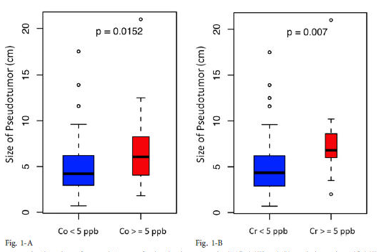
PUBLISHING IN JBJS
MANUSCRIPT PREPARATION
TEXT = STORY…..TABLES = DATA….FIGURES = ILLUSTRATE
FIGURES AND TABLES
TABLES BRING DATA TOGETHER
NUMBERS MUST MATCH NUMBERS IN TEXT
FIGURES TO ILLUSTRATE YOUR MAIN POINTS OF MANUSCRIPT
USE GRAPHS AND BOX PLOTS TO SHOW COMPARISON
FOR IMAGING FIGURES, SHOW A RANGE OF RESULTS
LIMIT OF TOTAL 6 TO 8 FIGURES/TABLES TYPICAL FOR JBJS

Slide 24
PUBLISHING IN JBJS
JBJS MOTTO: “EXCELLENCE THROUGH PEER REVIEW”
WHAT DO WE CONSIDER PEER REVIEW?
READERS VALUE ‘TRUSTED’ INFORMATION
REVIEW BY PEERS
WITH SIMILAR EDUCATION/TRAINING
EXTERNAL REVIEW
EXPERTS ON THE TOPIC INVITED TO REVIEW MANUSCRIPT
USUALLY 2 OR 3 REVIEWERS FOR EACH MANUSCRIPT
INTERNAL REVIEW
BY EDITORIAL BOARD AND STAFF
COLLATES RESULTS OF EXTERNAL REVIEWERS

Slide 25
PUBLISHING IN JBJS
POTENTIAL LIMITATIONS OF PEER REVIEW
…BUT STILL BETTER THAN ALTERNATIVES
SUBJECTIVE
BIAS MAY BE SUBTLE
OPEN TO ABUSE
SLOW AT TIMES
EXPENSE OF STAFF
FRAUD DETECTION ALMOST IMPOSSIBLE
CRITERIA MAY BE DIFFERENT FOR EACH JOURNAL

Slide 26
PUBLISHING IN JBJS
MANUSCRIPT PROCESS AT JBJS
MANUSCRIPT SUBMITTED
STAFF CHECKS FOR SEVERAL ITEMS
WORD COUNT
BLINDING OF MANUSCRIPT FOR REVIEWERS
DO NOT KNOW AUTHOR NAMES OR INSTITUTION
COMPLETENESS OF FIGURES AND TABLES
DISCLOSURES OF CONFLICT OF INTEREST (ICMJE)
FOR ALL AUTHORS

Slide 27
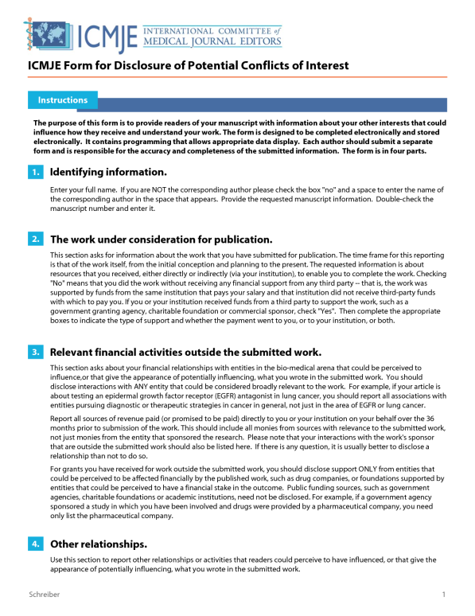
PUBLISHING IN JBJS
CONFLICT OF INTEREST DISCLOSURE
ICMJE FOR HUNDREDS OF JOURNALS WORLDWIDE
REQUIRED BY JBJS BEFORE MANUSCRIPT SENT FOR REVIEW
DOES NOT INCLUDE $$ AMOUNTS
VARIES WITH JOURNAL ON HOW THIS INFORMATION IS USED
INDUSTRY TIES IMPORTANT TO NOTE
INDUSTRY SUPPORT DOES NOT IMPACT
CHANCE OF PAPER ACCEPTANCE
--JUST NEEDS TO BE DISCLOSED
--MANY OF JBJS AUTHORS WITH
INDUSTRY TIES
ICMJE = INTERNATIONAL COMMITTEE
OF MEDICAL JOURNAL EDITORS

Slide 28
PUBLISHING IN JBJS
CONFLICTS AND REPORTED STUDY OUTCOMES?
STUDY ON THROMBOPROPHYLAXIS (Lee, JBJS, 2012)
2/52 industry-sponsored →negative results, others 3/14 negative
Of articles in Medline 1980-2002 significant relationship between industry sponsorship and pro-industry conclusions…odds ratio 3.6
Khan et al. in ortho 5 major journals 2002-2004 with strong statistical link between industry funding and favorable outcomes
Reasons for bias?
Publication bias with favorable results more often published
Suppression of publication by sponsor for unfavorable results
Study design, particularly with non-inferiority study

Slide 29
PUBLISHING IN JBJS
RELATIONSHIP WITH DECLARED FUNDING SUPPORT & LOE
Review of JBJS 2003-2007
246/889 studies funded by industry
50% level 4 evidence, 37% I or II
274 funded by govt, foundation, universities 29% level 4,55% 1/2
366 studies with no funding, 57% level 4
Association between industry funding and lower LOE (P<0.0001)
Noordin, et al., JBJS 2010

Slide 30
PUBLISHING IN JBJS
MANUSCRIPT SUBMISSION AT JBJS (continued)
ASSIGNED TO EDITOR-IN-CHIEF
ASSIGNS CLASSIFICATIONS TO IDENTIFY REVIEWERS
ASSIGNED TO DEPUTY EDITOR BY SPECIALTY
MAY REJECT WITHOUT FURTHER REVIEW (15%-20%)
POOR STUDY DESIGN
BETTER SUITED FOR SUBSPECIALTY JOURNAL
INADEQUATE FOLLOW-UP
LITTLE OR NO NEW INFORMATION
SENT FOR REVIEW TO 2 OR 3 REVIEWERS
WHEN REVIEWS COMPLETE, DEPUTY EDITOR COLLATES
DECIDES IF NEEDS METHODOLOGY/STATISTICS REVIEW
SUBMITS RECOMMENDED DECISION TO EDITOR

Slide 31
PUBLISHING IN JBJS
PROCESS AT JBJS (continued)
DECISION BY EDITOR SENT TO AUTHORS
IF ASKED TO REVISE, AUTHORS COMPLETE REVISION
REVISION MANUSCRIPT REVIEWED
BY DE & OFTEN 1 OR MORE OF ORIGINAL REVIEWERS
CYCLE CONTINUES UNTIL DE AND EDITOR SAY ‘READY’
FINAL EDITING DONE BY EDITOR-IN-CHIEF
SENT FOR COPY EDITING AND PUBLICATION
OFTEN QUERIES FOR AUTHORS
THEY DO NOT DELETE TEXT AFTER FINAL EDITOR APPROVAL

Slide 32
Editor
Copy Editor #1
DeputyEditor
Reviewers
Author
Statistics
The first or second revision may be reviewed by a Deputy Editor for Statistics and Methodology

Slide 33
Editor
Copy Editor #1
DeputyEditor
Copy Editor #2
Desktop Publishing
Reviewers
Author
Statistics
Publisher

Slide 34
Country | Submitted
Australia | 23
Belgium | 17
Canada | 92
China | 93
France | 20
Germany | 51
India | 34
Italy | 20
Japan | 75
Korea | 104
Netherlands | 63
Sweden | 8
UK | 119
US | 1037
Total | 2014
2012 Manuscripts submitted by country
Usually about 50%
from outside USA

Slide 35
TABLE 2 Country of Origin for 2013 JBJS Submissions
Country | 2012 | % of Total | 2013 | % of Total
BRAZIL | 19 | 1% | 8 | 0%
CANADA | 90 | 4% | 67 | 4%
CHINA | 93 | 5% | 74 | 5%
FINLAND | 12 | 1% | 13 | 1%
FRANCE | 20 | 1% | 17 | 1%
GERMANY | 51 | 3% | 41 | 3%
INDIA | 34 | 2% | 12 | 1%
ISRAEL | 14 | 1% | 8 | 0%
ITALY | 20 | 1% | 19 | 1%
JAPAN | 65 | 3% | 75 | 5%
KOREA, REPUBLIC OF | 104 | 5% | 95 | 6%
NETHERLANDS | 63 | 3% | 46 | 3%
SWITZERLAND | 28 | 1% | 20 | 1%
UNITED KINGDOM | 119 | 6% | 64 | 4%
UNITED STATES | 1037 | 51% | 874 | 54%

Slide 36
JBJS Scientific Manuscripts Received
 | 2004 | 2005 | 2006 | 2007 | 2008 | 2009 | 2010 | 2011 | 2012
Research | 351 | 331 | 237 | 302 | 313 | 285 | 304 | 363 | 288
Clinical | 559 | 661 | 768 | 873 | 956 | 952 | 1106 | 1243 | 1343
Total | 910 | 992 | 1005 | 1175 | 1269 | 1237 | 1410 | 1606 | 1631
Product | 2011 | 2012 | 2013 (01-08)
JBJS | 2024 | 2014 | 1075
Case Connector | 214 | 362 | 212
Essential Surg Techniques | 36 | 17 | 30
JBJS Reviews | NA | NA | 44
Total | 2274 | 2393 | 1361
All article types

Slide 37
PUBLISHING IN JBJS
GENERAL PRINCIPLES FOR JBJS REVIEWERS
ADVISING THE EDITORS FROM EXPERT VIEWPOINT
EDITORS MAKE FINAL DECISION
CONSTRUCTIVE CRITICISM, NOT NEGATIVITY URGED
ASK REVIEWERS TO AVOID PEJORATIVE LANGUAGE
KEEP CONFIDENTIALITY
DATA SHOULD NOT BE DISCUSSED UNTIL PUBLISHED
TIMELY REVIEW IF ACCEPT ASSIGNMENT
ALL AUTHORS PREFER QUICK DECISION
REVIEWERS DISCLOSE POSSIBLE CONFLICTS OF INTEREST
MAIN PURPOSE→ IMPROVE WHAT IS PUBLISHED

Slide 38
PUBLISHING IN JBJS
WHAT ARE WE LOOKING FOR?
IMPORTANCE OF TOPIC
IS INFORMATION ON THIS TOPIC WIDELY SOUGHT?
RELAVANCE TO READERS
DATA WIDELY APPRECIATED BY READERS
BETTER SUITED FOR A SUBSPECIALTY JOURNAL?
ORIGINALITY
NEW IDEA PREFERRED OVER CONFIRMATORY STUDY
WILL IT LEAD TO BETTER PATIENT CARE?
IMPORTANT FOR CLINICAL JOURNAL
VALIDITY OF REPORTED FINDINGS

Slide 39
PUBLISHING IN JBJS
POTENTIAL BIASES FOR REVIEWERS
POSITIVE RESULTS PUBLISHED MORE OFTEN
IMPORTANT TO INCLUDE NEGATIVE STUDIES
WRITING UNEVEN FROM NON-ENGLISH SPEAKERS
REVIEWER TOLD TO COMMENT ON SCIENTIFIC DATA
REVIEWERS TOLD NOT TO COMMENT ON ENGLISH
COPY EDITORS CAN CORRECT TEXT LANGUAGE
HOWEVER….
IF POSSIBLE, HAVE SOMEONE PROFICIENT IN ENGLISH READ BEFORE MANUSCRIPT SUBMISSION

Slide 40
PUBLISHING IN JBJS
POTENTIAL BIAS FOR REVIEWERS
THEIR POINT OF VIEW MAY AGREE WITH YOUR FINDINGS
THEY MAY RECOGNIZE AUTHOR EVEN WITH BLINDING
IN ONE STUDY, IDENTIFIED AUTHOR 24%-50% OF TIME
CONFLICTS OF INTEREST
INDUSTRY TIES OR SAME AREA OF RESEARCH
JBJS REVIEWERS ASKED TO DECLARE ALL CONFLICTS
WILL REPLACE REVIEWER WITH DIRECT CONFLICT

Slide 41
PUBLISHING IN JBJS
FEATURES OF MANUSCRIPT NOTED IN REVIEW
IMPORTANCE OF RESEARCH QUESTION
ARE FINDINGS ESSENTIAL FOR READERS TO KNOW?
IS THIS APPLICABLE TO PATIENT CARE AND PRACTICE?
THIS CONSIDERATION IS VERY IMPORTANT
EVEN RCTs MAY NOT ADDRESS ISSUE OF IMPORTANCE
ORIGINALITY
THOROUGH LITERATURE SEARCH ON THE TOPIC
REVIEWERS ARE PROVIDED WITH LINKS TO SEARCH
GIVEN CITATIONS OF SIMILAR ARTICLES
EVEN IF NOT NEW, MAY BE LARGER STUDY COHORT
METHODOLOGY MAY BE BETTER THAN PRIOR STUDY
REVIEWER MAY ADD REFERENCES YOU HAVE NOT CITED
YOU NEED TO INCLUDE AND COMMENT IN REVISION

Slide 42
PUBLISHING IN JBJS
FEATURES OF MANUSCRIPT NOTED IN REVIEW
VALIDITY
IS STUDY DESIGN APPROPRIATE FOR QUESTION?
STRENGTHS AND WEAKNESSES OF STUDY IDENTIFIED
CONSTRUCTIVE COMMENTS AND QUESTIONS
ARE CONCLUSIONS SUPPORTED BY DATA?
OVERREACHING CONCLUSIONS COMMON
CHECK TABLES AND NUMBERS FOR CORRECTNESS
PARTICULARLY DO NUMBERS IN TEXT MATCH?
DATA COLLECTION AND METHODS COMMENTED ON
UNDERPOWERED STUDIES COMMON IN ORTHO
WILL SEND TO METHODS/STATS EDITORS
REVIEW STUDY DESIGN AND PROPER USE OF STATISTICS
ALL LEVEL 1 AND 2 STUDIES, SOME 3, WITH THIS REVIEW

Slide 43
PUBLISHING IN JBJS
FEATURES OF MANUSCRIPT NOTED IN REVIEW
PRESENTATION
BALANCE OF TEXT, TABLES, AND FIGURES
TEXT = STORY….TABLES = DATA…FIGURES =ILLUSTRATE
SUCCINCTNESS VALUED
DOES ABSTRACT ACCURATELY REFLECT FINDINGS?
OFTEN MAY NOT
FOR SPECIFIC QUESTIONS, LINE NUMBER REFERRED TO
FOR AUTHOR TO IDENTIFY QUESTION FOR REVISION
ETHICAL ISSUES
ANY ETHICAL ISSUES EVEN WITH IRB APPROVAL?
SOME COUNTRIES DO NOT HAVE ETHICAL REVIEW

Slide 44
PUBLISHING IN JBJS
WHAT DO DECISION GRADES MEAN?
C REJECT WITHOUT REVIEW
DECISION BY DEPUTY EDITOR AND EDITOR
NOT SENT TO REVIEWERS
ABOUT 15%-20% OF MANUSCRIPTS
C-REJECT
REVIEWERS CRITICAL OF STUDY
MAY REJECT ON METHODS/STATS REVIEW ALONE
AUTHORS NOT INVITED TO REVISE AND RE-SUBMIT
C+ REVISE
TECHNICALLY AN INITIAL REJECTION
AUTHORS INVITED TO REVISE
BUT NOT ACCEPTED AT THIS STAGE
RE-REVIEW OF REVISION → DECISION MADE
ABOUT 2/3 WITH EVENTUAL ACCEPTANCE

Slide 45
PUBLISHING IN JBJS
WHAT DO DECISION GRADES MEAN? (continued)
B REVISE
INITIAL REVIEWS RELATIVELY POSITIVE
ALMOST ALL ARE ACCEPTED AFTER REVISIONS
A REVISE
EXCELLENT REVIEWS, < 10% ON INITIAL REVIEW WITH ‘A’
WILL BE PUBLISHED AFTER MINOR REVISION
ALMOST REVISE
ESSENTIALLY NEVER USED BY REVIEWERS
USED BY EDITORS WITH MINOR FINAL CONCERN
READY
FULLY ACCEPTED AND SENT TO BE PUBLISHED
DECISION MADE BY DEPUTY EDITOR AND EDITOR
THIS DECISION IS NOT USED BY REVIEWERS

Slide 46
PUBLISHING IN JBJS
HOW TO RESPOND TO A REVIEW
THREE CRITICAL ELEMENTS NEEDED
COVER LETTER
DOCUMENT OR TABLE LISTING CHANGES YOU MADE TO TEXT
REVISION MANUSCRIPT CLEARLY NOTING CHANGES MADE
KEEP THE REVISION SUCCINCT
ADDED TEXT USUALLY NEEDED TO RESPOND TO REVIEWS
NEED TO CUT SOME TEXT AS WORD LIMIT STILL APPLIES TO REVISION

Slide 47
Response to Review : Cover Letter
The purpose of the cover letter is not to have a discussion with the Editor or Reviewers.
If the reviewers ask a question, then we can expect readers of the manuscript to have the same question. So the answer to the question must be contained in the manuscript, not the cover letter.
The only reason to use the cover letter for a discussion, is if you disagree with the reviewer and do not intend to change your manuscript.
Otherwise, every reviewer’s comment must correspond to a change in the manuscript (however minor).
It is best to have a separate document or table that describes the changes.

Slide 48
Response to Review : Cover Letter to Editor
Dear Dr. Tolo,
Please find enclosed our revised manuscript #JBJS-14-00xx, entitled: “…”.
We appreciate the reviewers’ helpful comments and have included a separate table that indicates how our manuscript has been modified in response to each comment. The changes are highlighted in our revised manuscript in bold text.
Thank you for your consideration of this revised manuscript.
Sincerely,

Slide 49
Response to Review :
Indicating How the Manuscript has been Changed
Reviewer Comment: “Page 5, line 86-90: What to use as the gold standard for the diagnosis of infection will always be a matter of debate, but mention more specifically what criteria you used.”
“We used criteria recommended by the Musculoskeletal Infection Society as the gold standard for diagnosing infection.”
“We have modified our manuscript to indicate that we used criteria recommended by the Musculoskeletal Infection Society as the gold standard (now Page 5, lines 95-100) and we included a reference citation to those criteria (new reference #3).”

Slide 50
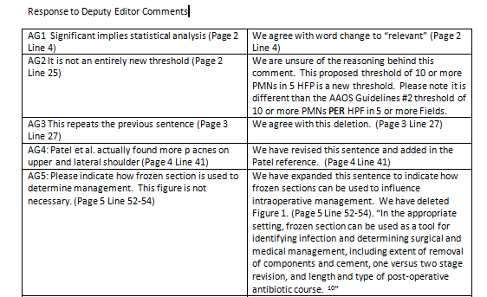
Response to Review
Table Indicating How the Manuscript has been Changed

Slide 51
JBJS: Manuscripts Published by Category
 | 2010 | 2011 | 2012 | 2013 (01-08)
Spine | 10 | 19 | 18 | 14
Hip Reconstruction | 35 | 32 | 33 | 19
Knee Reconstruction | 24 | 27 | 20 | 14
Foot & Ankle | 27 | 20 | 26 | 17
Shoulder & Elbow | 39 | 24 | 44 | 20
Hand | 10 | 19 | 10 | 8
Sports | 13 | 12 | 22 | 13
Trauma | 28 | 25 | 42 | 26
Pediatrics | 40 | 17 | 24 | 27
Oncology | 6 | 8 | 10 | 3
Practice Management | 0 | 2 | 0 | 0
Basic Science | 44 | 21 | 33 | 23
Misc | 10 | 2 | 1 | 3
Total | 295 | 233 | 288 | 196

Slide 52
PUBLISHING IN JBJS
VIOLATIONS OF PUBLICATION ETHICS
DUPLICATE PUBLICATION
MAY BE SAME ARTICLE IN 2 LANGUAGES
SAME DATA BUT DIFFERENT AUTHORS
PLAGIARISM
USE PUBLISHED MATERIAL WITHOUT ATTRIBUTION
RESULTS AND DISCUSSION TEXT AND DATA MUST BE UNIQUE
IF YOU INCLUDE MATERIAL YOU PREVIOUSLY PUBLISHED, YOU MUST CITE IT
SOFTWARE TO CHECK PLAGIARISM USED BY MANY JOURNALS
ALL REVISION MANUSCRIPTS AT JBJS ARE CHECKED

Slide 54
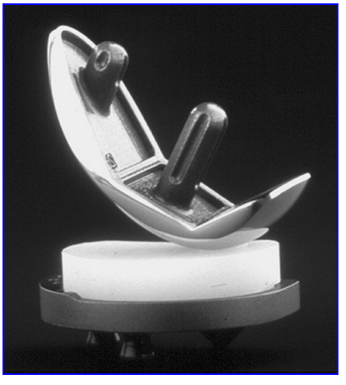
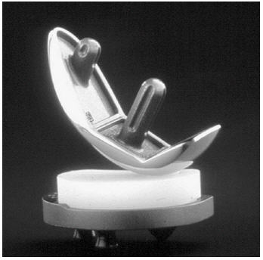
Figure in CORR publication
Figure in submitted JBJS manuscript

Slide 55
PUBLISHING IN JBJS
ALL AUTHORS MUST SIGN DOCUMENT
NOT PUBLISHED OR SUBMITTED TO ANOTHER JOURNAL
ORIGINAL INFORMATION
ALL AUTHORS HAVE READ MANUSCRIPT AND AGREE

Slide 56
PUBLISHING IN JBJS
PLAGIARISM CHECK SOFTWARE
CROSS-CHECK USED BY JBJS
WHAT TO DO WITH THIS INFORMATION
ACCEPT IF 20%-25% OR LESS
SELF-PLAGIARISM REQUIRES CITATION

Slide 57
PUBLISHING IN JBJS
CROSS-CHECK RESULTS
INVESTIGATE IF LARGE % MATCH
USE COPE GUIDELINES
NOW DUELING PROGRAMS FROM SAME COMPANY
GOOD OR NOT?

Slide 58
PUBLISHING IN JBJS
VIOLATIONS OF PUBLICATION ETHICS
FABRICATION OF DATA
PUBLISHING DELIBERATELY FALSE OR MISLEADING DATA
IMAGE MANIPULATION
MAKING ANY CHANGE IN ORIGINAL IMAGE UNACCEPTABLE
CHANGE OF AUTHORS
ALL AUTHORS MUST AGREE TO ORDER OF AUTHOR
IF AUTHOR CHANGE, ALL AUTHORS MUST AGREE IN WRITING

Slide 59
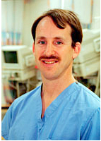
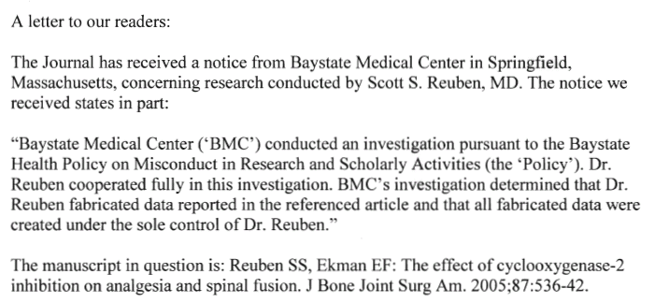
Feb. 2009 - Retraction

Slide 60
PUBLISHING IN JBJS
NUMBER OF RETRACTIONS INCREASING
http://retractionwatch.wordpress.com

Slide 61
A letter to our readers (November 20, 2013):
I regret to inform you that possible unethical author behavior has been identified with regard to a previously published article in The Journal of Bone and Joint Surgery, namely “Skin-Derived Fibroblasts for the Treatment of Refractory Achilles Tendinosis: Preliminary Short-Term Results,” with authors H. Obaid, A. Clarke, P. Rosenfeld, C. Leach, and D. Connell. The citation for this article is J Bone Joint Surg Am. 2012 Feb 1;94(3):193-200.
The Journal of Bone and Joint Surgery received a letter from the Medicines and Healthcare products Regulatory Agency (MHRA) in the United Kingdom, stating that the trial on which this study was based was performed without authorization from the MHRA and without a favorable ethical opinion from a recognized research ethics committee, both of which are required by the Medicines for Human Use (Clinical Trials) Regulations (2004).
Additionally, the MHRA stated that permission was not obtained from the organization where the research was undertaken, as required by the Department of Health Policy. It has been reported to me that the research patients were treated at a private practice facility. There are differing reports as to whether or not the lead author, Dr. David Connell, retained records of his research findings.
It has been reported to me that there is an ongoing investigation in the United Kingdom by the General Medical Council (GMC) into possible unethical behavior. We will inform our readers of the outcome of this investigation when it is complete.
Respectfully submitted,
Vernon T. Tolo, MD
Editor-in-Chief

Slide 62
Already cited in 11 publications identified in a Pubmed search 11/26/2013, including:
Semin Arthritis Rheum 2013;42:651-666

Slide 63
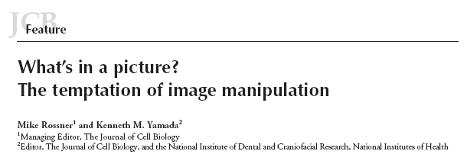
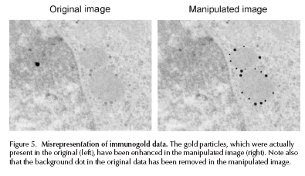
J Cell Biol 166:11-15, 2004

Slide 64
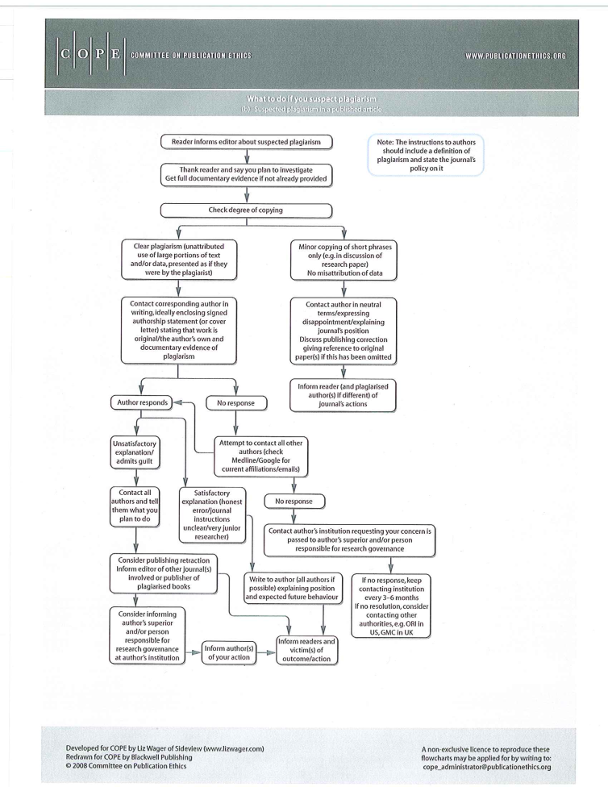
PUBLISHING IN JBJS
COMMITTEE ON PUBLICATION ETHICS (COPE)
www.publicationethics.org
DEALS WITH VIOLATION OF PUBLICATION ETHICS
PROVIDES FLOWCHARTS FOR AUTHOR ISSUES
DUPLICATE PUBLICATION
PLAGIARISM
FABRICATED DATA
AUTHORSHIP CHANGES
UNDISCLOSED CONFLICTS
(COMPLAINTS AGAINST EDITOR)

Slide 65
COPE FLOWCHARTS FOR EDITOR

Slide 66
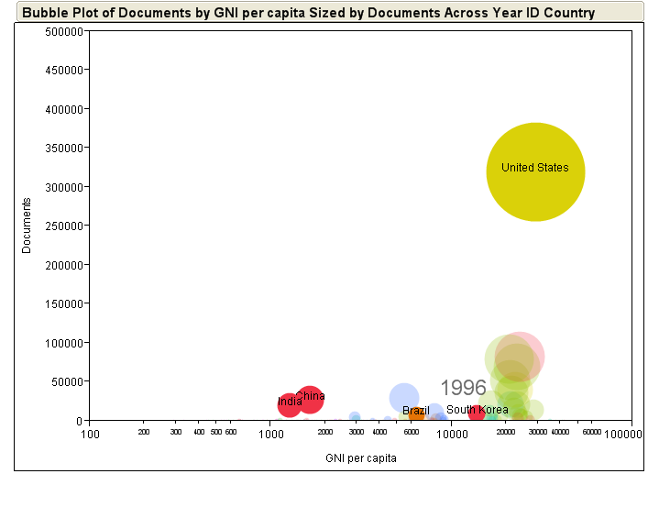
GLOBAL PUBLISHING--1996

Slide 67
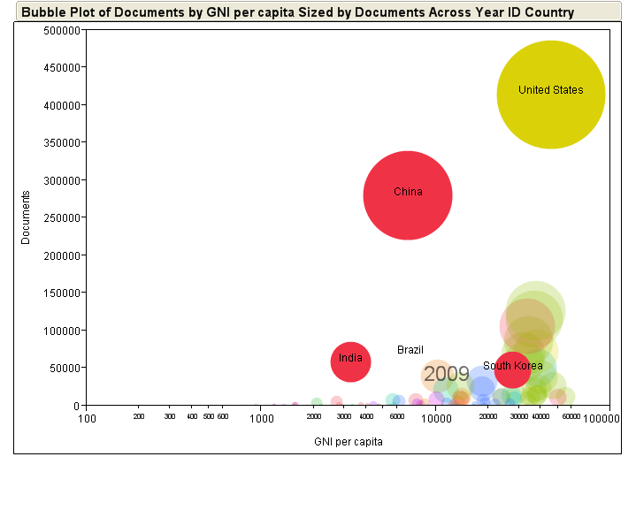
GLOBAL PUBLISHING--2009

Slide 68
Number of Manuscripts from China
Received at JBJS
2002 - 2013
 | 2003 | 2004 | 2005 | 2006 | 2007 | 2008 | 2009 | 2010 | 2011 | 2012
Received | 5 | 5 | 18 | 14 | 27 | 38 | 61 | 75 | 54 | 93
Accepted | 2 | 3 | 1 | 1 | 0 | 3 | 5 | 2 | 2 | 4
Year to Year data is complex because the review process for many manuscripts extends from one year to the next
Of the 93 manuscripts received from China in 2012, 4 were accepted. The remainder were either rejected, withdrawn, or transferred (e.g. to JBJS Case Connector).

Slide 69
Most Important Comments in 50 Rejected JBJS Manuscripts from China
Unclear number of patients/specimens; unknown rationale for “n” (10)
Manuscript would be better submitted to a basic science journal instead of JBJS (9)
I could not understand the experimental design or methods. Methods were too confusing (8)
An anatomy study only from cadavers (8)
Model too simplistic. Does not replicate a clinical condition (8)
No (or inappropriate) controls (8)

Slide 70
Most Important Comments in 50 Rejected JBJS Manuscripts from China
Unclear hypothesis or objectives (5)
Lack of quantitative or objective results (4)
In vitro only; not relevant enough for JBJS (4)
Not new (does not add new information) (4)
Authors overlooked recent literature (3)
Authors ignored important limitations (2)
Misleading interpretation of results (3)
Unsatisfactory histology (2)

Slide 71
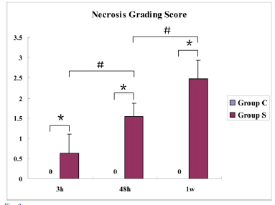
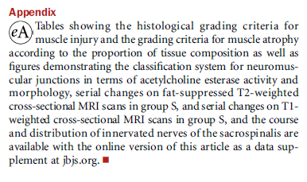
JBJS 2013;95:e192(1-9)

Slide 72
PUBLISHING IN JBJS
SCIENTIFIC FACTORS ASSOCIATED WITH JBJS ACCEPTANCE
1181 MANUSCRIPTS EVALUATED
BOTH POSITIVE AND NEGATIVE STUDIES
ONLY FACTOR ASSOC. WITH ACCEPTANCE WAS LEVEL OF EVIDENCE
Okike , et al., JBJS, 2008
NON-SCIENTIFIC FACTORS ASSOCIATED WITH JBJS ACCEPTANCE
FROM USA OR CANADA
HAD CONFLICT OF INTEREST WITH NONPROFIT ENTITY (not industry)
AUTHORED BY INDIVIDUAL WITH >10 ARTICLES IN CITED ORTHO J.
Okike. et al., JBJS, 2008
SEEKING MORE INTERNATIONAL INVOLVEMENT
HAVE INTERNATIONAL DEPUTY EDITORS ON EDITORIAL BOARD NOW
HAVE GREATLY INCREASED NUMBER OF INTERNATIONAL REVIEWERS

Slide 73
PUBLISHING IN JBJS
WE KNOW YOU HAVE INTERESTING RESEARCH
WE LOOK FORWARD TO RECEIVING YOUR
NEW AND INNOVATIVE RESEARCH REPORTS
THANKS VERY MUCH FOR YOUR INVITATION!

